Slide 1
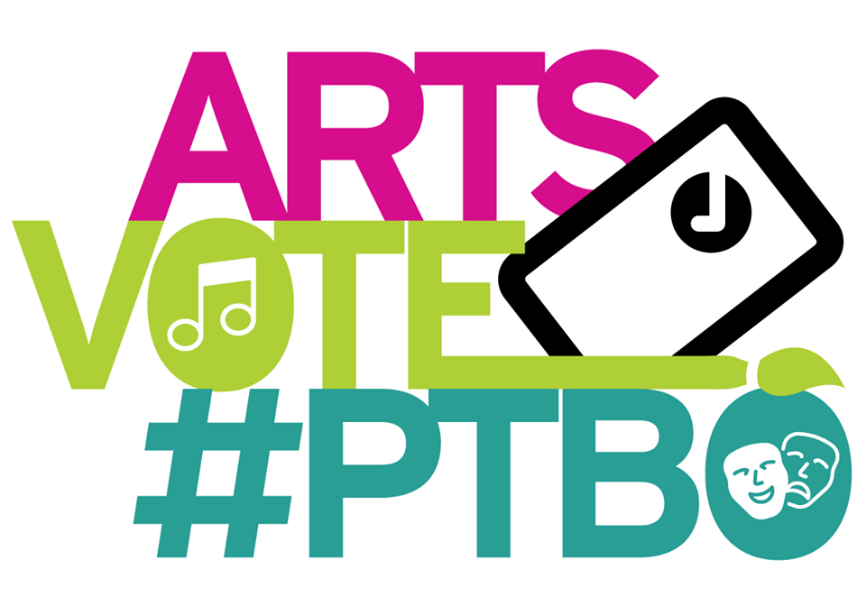

Slide 2

The Electric City Culture Council

Slide 3




Slide 5
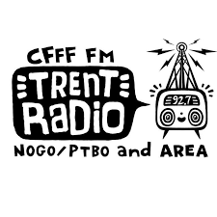








Artsvote Peterborough Coalition
The Theatre on King

Slide 6
VOTE on October 22nd!

Slide 7

Thanks to the City of Peterborough for all of your support for the Arts, Culture and Heritage sector

Slide 8
Thanks to the candidates!

Slide 9
Thanks Local Artists
For your imagination, creativity and dedication, for subsidizing your own work, for donating your work to so many charitable causes, for fundraising and for your extraordinary volunteerism in the Peterborough community!

Slide 10
Thanks to the Sponsors
To all the small businesses, corporations and foundations that sponsor arts organizations and heritage institutions in Peterborough.

Slide 11
Thanks to all the Volunteers
Thanks to the estimated 3000+ arts volunteers in Peterborough for your support!

Slide 12
Thanks to our Audiences
For coming out, buying tickets and making it all worth while.

Slide 13
Audiences
We checked in with just 12 of the approximately 120 arts organizations in Peterborough and their attendance was over 200,000 people last year.
As Mayor Bennett often reminds us, more citizens participate in the arts than in sports.

Slide 14
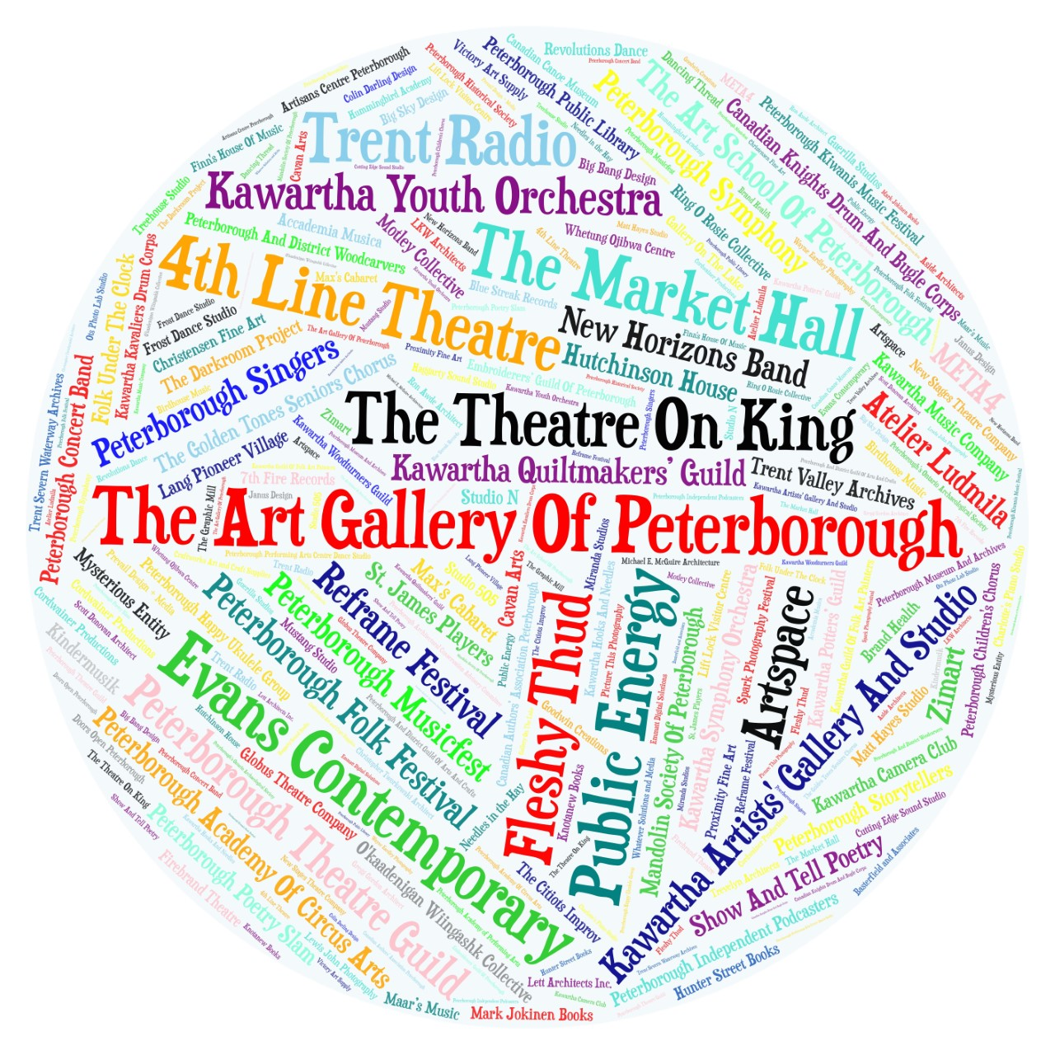
Who Are We?

Slide 15
The Electric City Culture Council

Slide 18
Artsvote Peterborough Coalition
The Theatre on King

Slide 19
VOTE on October 22nd!

Slide 20
Who We Are!

Slide 21
Performing Arts
Theatre Historical Drama Musical Theatre Improv Fringe Theatre Serial Drama Dance Contemporary Dance Ballet Movement One Woman/Man Show Opera Radio Drama Monologue Bollywood Shakespeare New Play Development Script Reading Workshops Site Specific Absurdist Local Content Experimental Performance Art Circus Arts…

Slide 22
Visual Arts and Media Arts
Paintings Sculpture Ceramics Film Video Photography Digital Arts Textiles Woodworking Encaustic Murals Stained Glass Animation Illustration Drawing Workshops Exhibitions Installation Art Art Crawls Printmaking Life drawing, Etching...

Slide 23
Music
Orchestra Rock Music String Quartet Folk Music Rap Hip Hop R&B Blues Classical Pop World Music Acoustic Electronic DJ Latin Songwriting Improvisation Jazz A Capella Drumming Brass Choir Experimental Drum Circle Round Dance Opera Cantata Country Western Swing...

Slide 24
Literary Arts
Plays Publishers Novels Spoken Word Poetry Prose Essays Opinion Pieces Fiction Biography Durational Reading Workshops Readings Book Launches Printing Presses Chapbooks Poetry Slams Speculative Fiction Fantasy Erotica Novella Non-Fiction Childrens’ Literature Short Story Reviews...

Slide 25
VOTE on October 22nd!

Slide 26
What do we do?

Slide 27
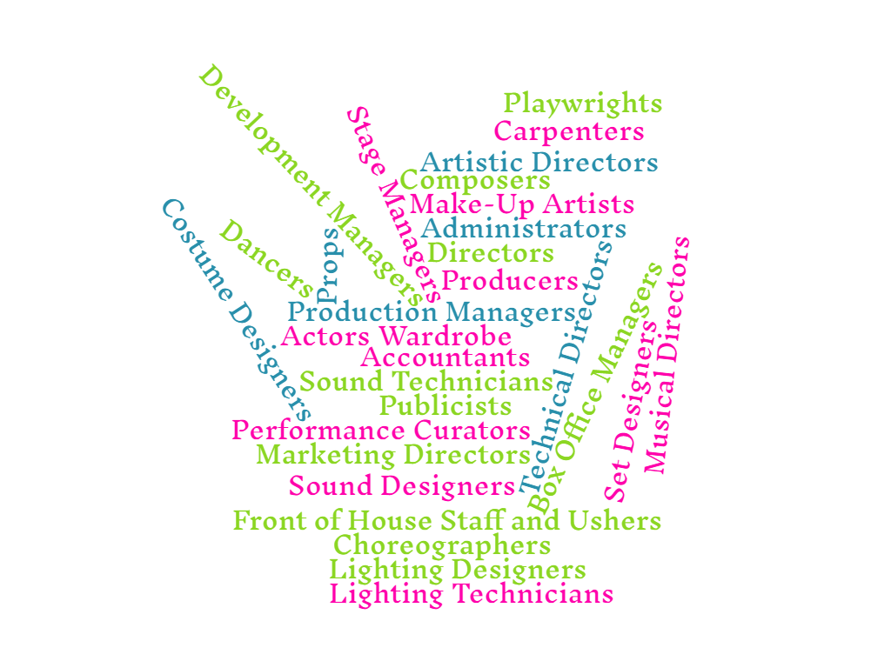
Performing Arts

Slide 28

Visual Arts
And Media Arts

Slide 29
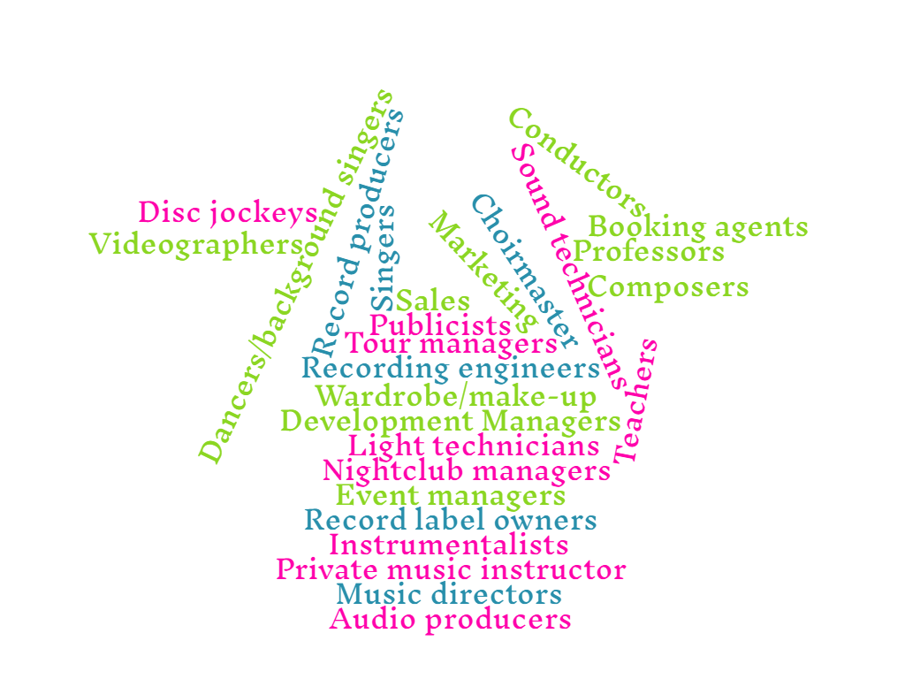
Music

Slide 30

Literary Arts

Slide 31
The Arts drive economic growth…
For every $1 invested in the arts, Peterborough cultural organizations generated $23.23 in the local economy in 2016.

Slide 32
Municipal Investment

Slide 33
Breakdown of Municipal Spending in 2017

Slide 34
Per-Capita Expenditure of Combined Municipal Investment

Slide 35
Community Grants

Slide 36
Project Grants
Total Number of Project Grants per year for ACH
Year | Total Grants Awarded | Annual Amount for ACH
2007 | 5 | $7,650
2008 | 5 | $1,000
2009 | 6 | $5,000
2010 | 6 | $4,800
2011 | 6 | $3,950
2012 | 6 | $4,700
2013 | 6 | $2,200
2014 | 6 | $5,050
2015 | 6 | $7,100
2016 | 7 | $7,400
2017 | 7 | $6,750

Slide 37
Combined Per-Capita Grant Expenditure on Arts, Culture and Heritage

Slide 38
Community Service Grants

Slide 39
Combined Investment and Service Grants

Slide 40
The Electric City Culture Council

Slide 43
Artsvote Peterborough Coalition
The Theatre on King

Slide 44
VOTE on October 22nd!

