Slide 1
AGM 2016

Slide 2
The EC3 2016 Agenda
Welcome
Acknowledgment of Indigenous Lands
Motion to Call the 2016 AGM to Order
Introductions and thanks to all for coming
Motion to Approve the Agenda of the 2016 EC3 AGM
Motion to Approve the Minutes of the 2015 EC3 AGM
Report of the Chair and President: Bill Kimball
Report of the Treasurer: Yvonne Lai
Motion to Accept the 2015/2016 Financial Statements (Notice to Reader/Compilation Review).
Motion to Appoint 2016 Auditor (Collins Barrow)
Report of the Executive Director: Su Ditta
Motion to Elect the Board of Directors (3 new members)
Welcome new Board members and acknowledge those leaving
Special Events and Announcements
Motion to Adjourn.

Slide 3
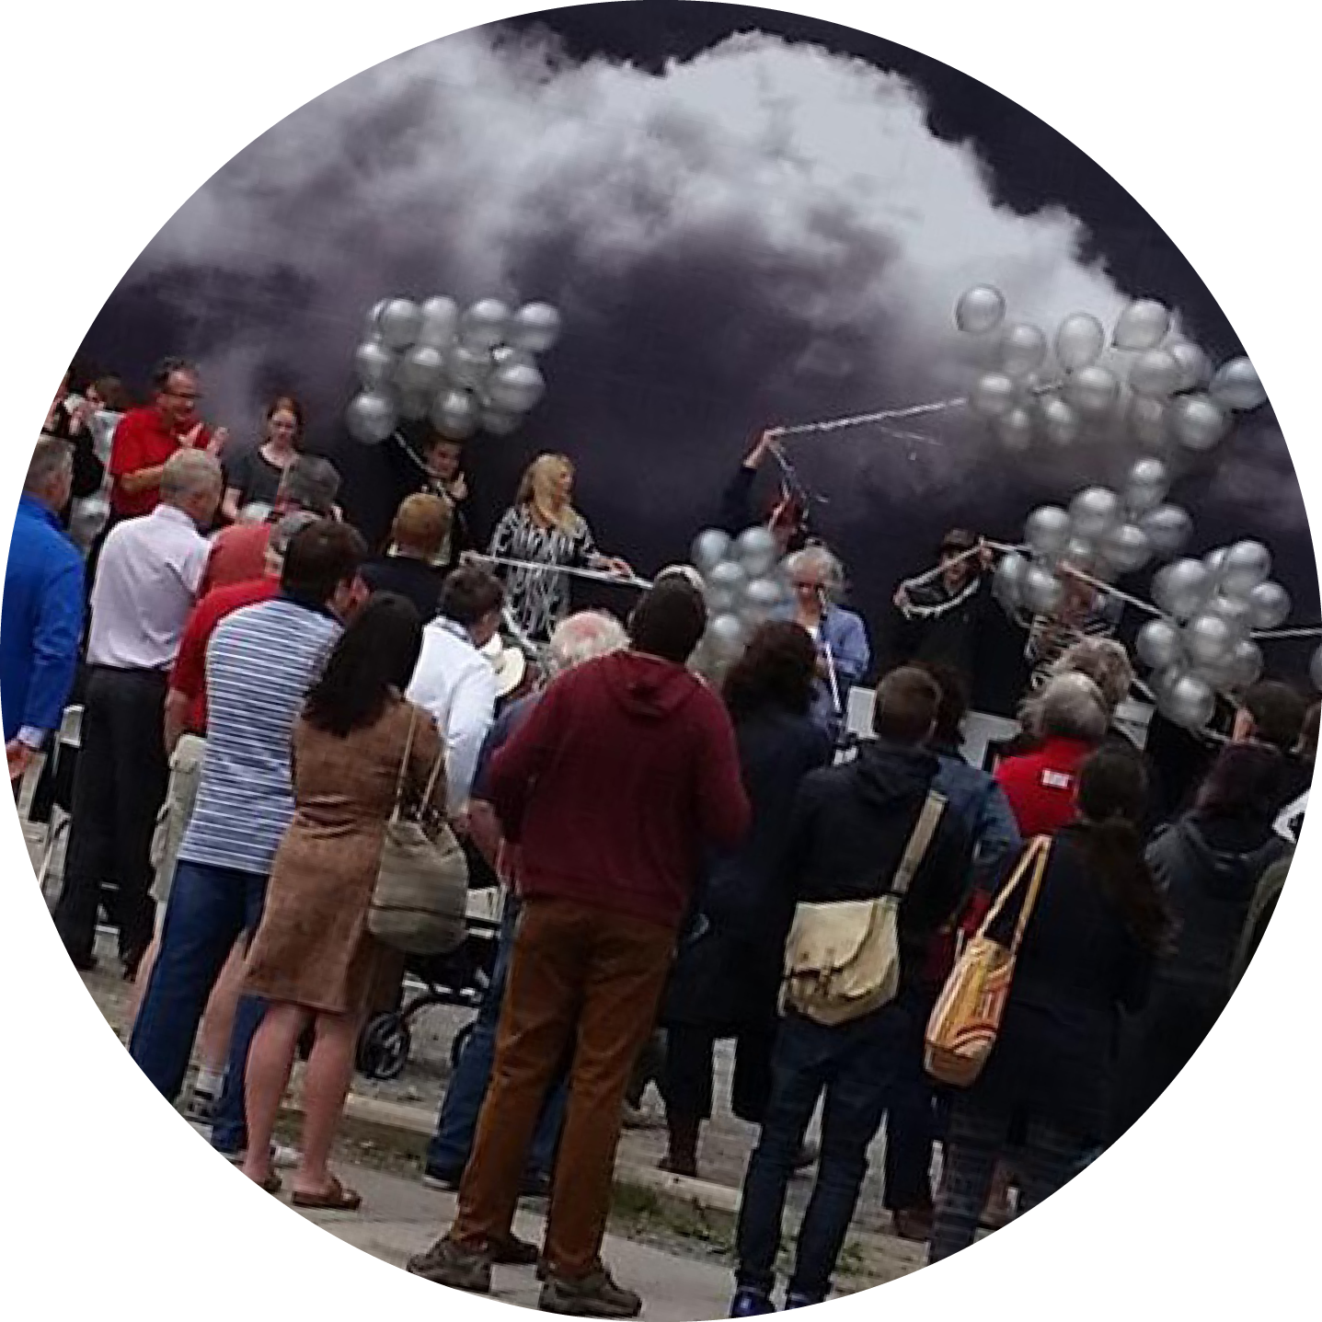

Slide 4
EC3 2016 AGM Financials

Slide 5
EC3 AGM Financials 2015/2016

Slide 6
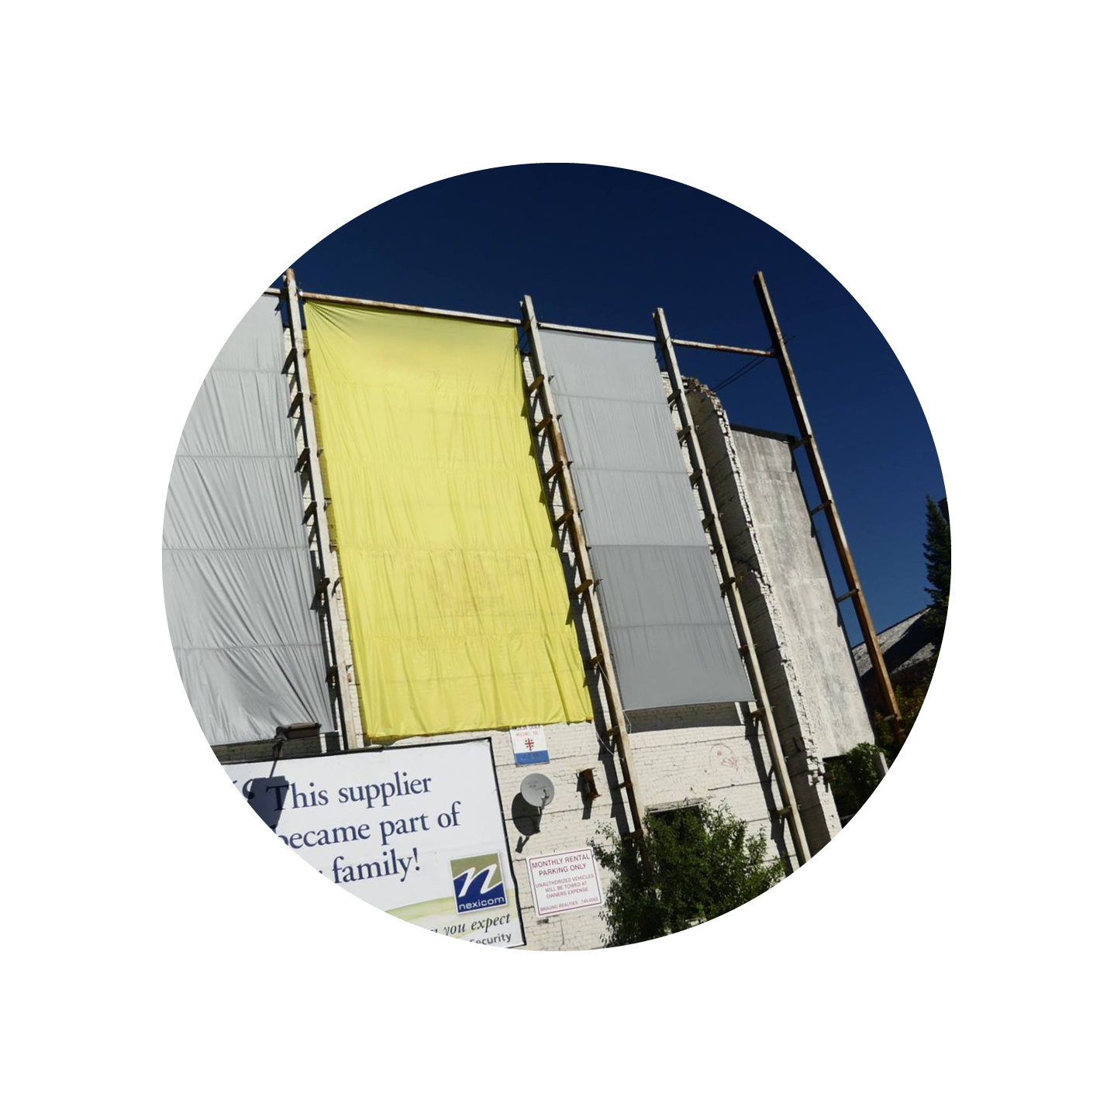
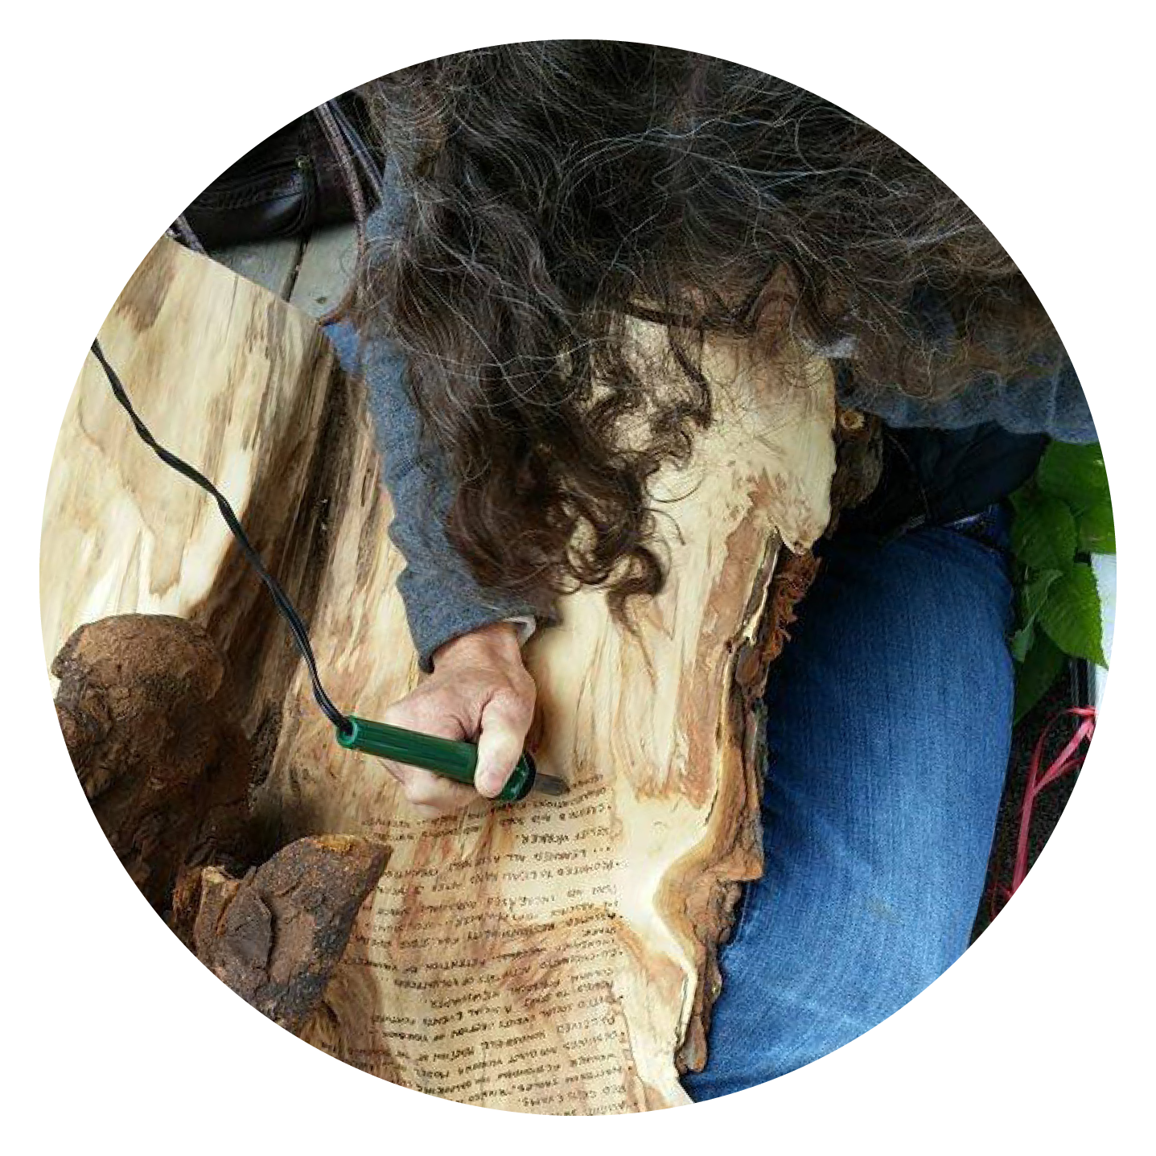

Slide 7
Election of New Board Members AGM 2016
Dave Tough
Nadine Changfoot
Jon Lockyer

Slide 8
Thank you to our Funders

