Slide 1
Annual General Meeting 2017

Slide 2
Territorial Acknowledgement

Slide 3
WHO WE ARE
The Electric City Culture Council (EC3) is a not-for-profit service organization dedicated to encouraging and supporting the arts, culture and heritage (ACH) sector in Peterborough and the surrounding area.

Slide 4
OUR MISSION
Our mission is to develop and strengthen the creative ecology of the region by connecting individuals and organizations, providing the leadership, advocacy, professional development, information, resources, networking, programming and collaborative partnerships that build the capacity of the local arts, culture and heritage community.

Slide 5
OUR JOB
Our job is to act as an antenna and sounding board for the ACH community, to identify challenges in the sector and develop and deliver services that will help our members and the broader creative community meet those challenges, discover new opportunities, implement useful and innovative strategies to strengthen their organizations and provide meaningful support to better serve artists, heritage professionals, cultural managers and audiences.

Slide 6
WHAT WE DO
Advocacy, strategic leadership and representation
Research and information about the local ACH sector
Professional development for individuals and organizations (workshops, clinics, mentorships)
New forums for exploring creative ideas, issues, interventions and innovations
Bring people together: dedicated sector coordination, connections and convening
Practical networking, collaboration and partnerships that build and strengthen the capacity and infrastructure of the arts, culture and heritage community, across and between other sectors

Slide 7
WHAT WE DO
Arts awareness
Collaborative/collective marketing initiatives
Information and resources for artists and arts managers
Awards programs to support artists and build recognition of local creators, arts supporters and cultural professionals
New creative programming initiatives that build bridges across different disciplines and community sectors and encourage public appreciation of and engagement with arts, culture and heritage activities
Support services for arts and heritage organizations.

Slide 8
HOW WE DO IT
Cultural Incubators
Professional development
Artsweek
Workshops
Arts Representation
Advocacy Initiatives
Arts Awards
Electric City Culturecast
Commissioning Programs
Special Projects
Cross Promotion and Communications
One on One Consultations
Research and Reporting.

Slide 9
Agenda
Annual General Meeting 2017

Slide 10
Electric City Culture Council (EC3)
5th Annual General Meeting (2017)
AGENDA
Report of the Treasurer: Yvonne Lai per Su Ditta
Motion to Accept the 2016/2017 Financial Statements (Notice to Reader/Compilation Review).
Motion to Appoint 2017/2018 Auditor (Collins Barrow)
Report of the Executive Director: Su Ditta
Motion to Elect the Board of Directors (2 new members)
Welcome new Board members and acknowledge those leaving
Special Events and Announcements: Door prizes, cultural incubator
Motion to Adjourn.
Welcome
Acknowledgment of Indigenous Lands
Motion to Call the 2017 AGM to Order
Introductions and thanks to all for coming
Performances: Unity Singers and Niambi Leigh
Motion to Approve the Agenda of the 2017 EC3 AGM
Motion to Approve the Minutes of the 2016 EC3 AGM
Report of the Chair and President: Bill Kimball

Slide 11
Approval of the EC3 2016 AGM Minutes
Annual General Meeting 2017

Slide 12
Report of the President:
Bill Kimball
Annual General Meeting 2017

Slide 13
Report of the Treasurer:
Yvonne Lai
Annual General Meeting 2017

Slide 14
EC3 Financial
Statements 2017
Annual General Meeting 2017

Slide 15
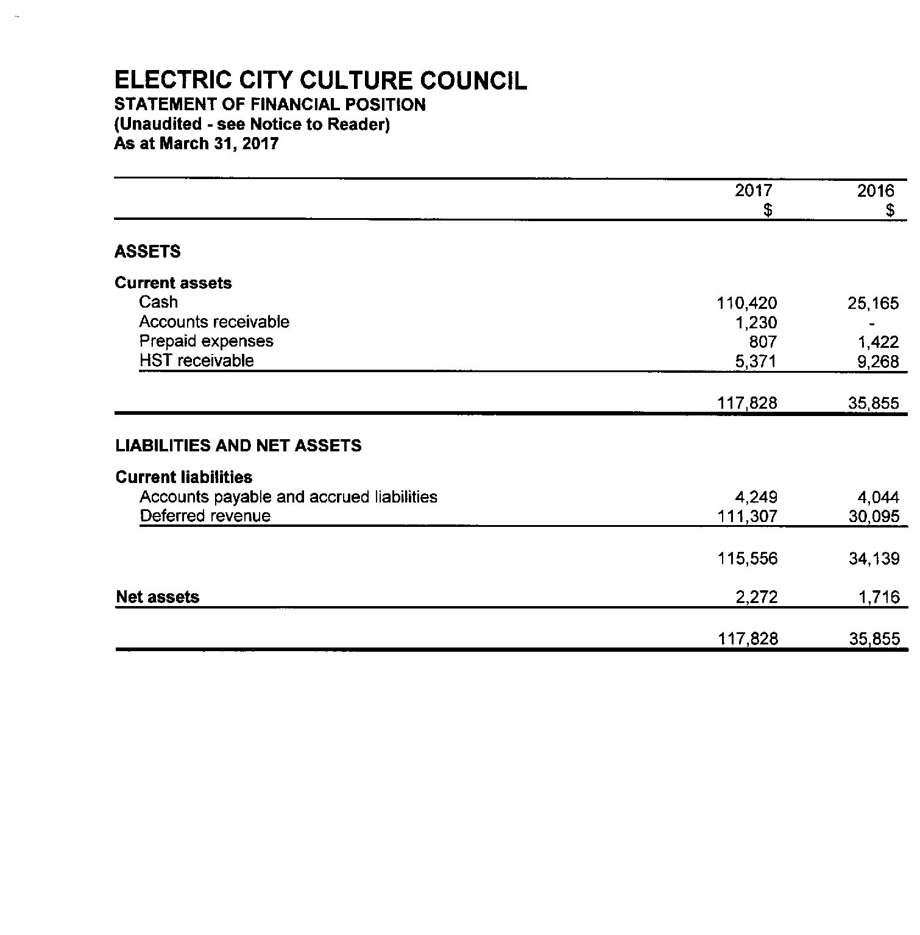
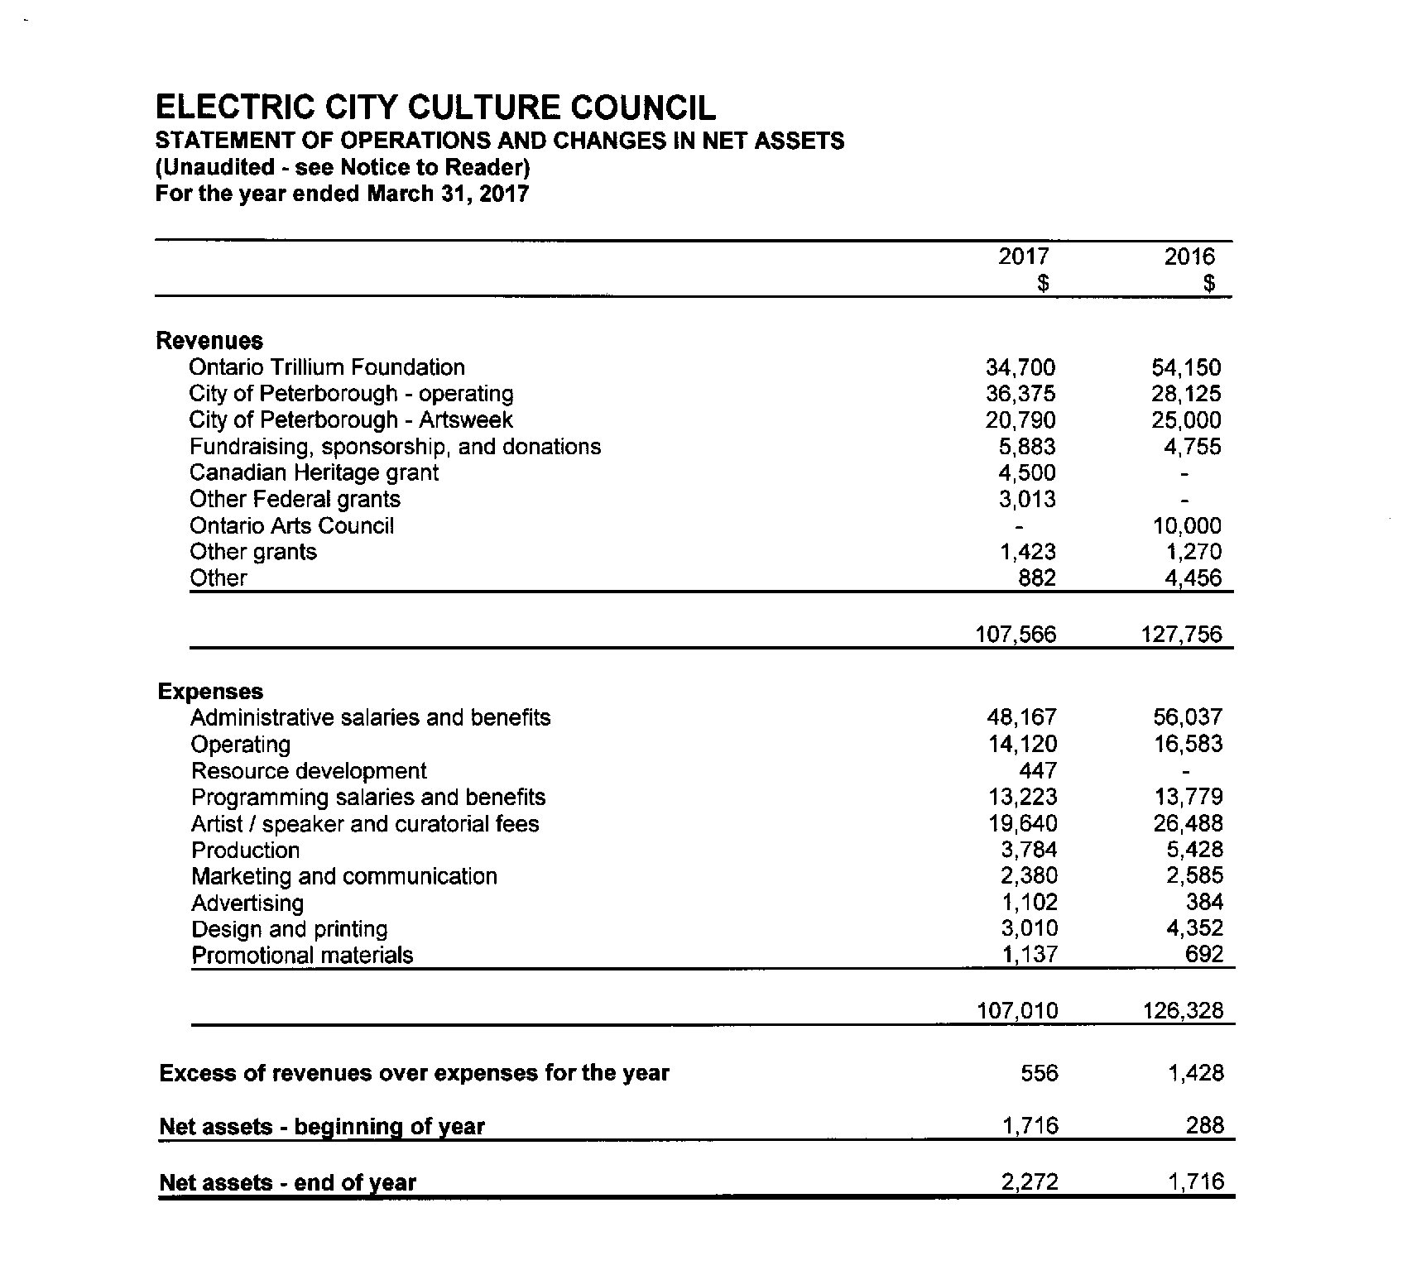

Slide 16
Appoint 2017-2018
Auditor (Collins Barrow)
Annual General Meeting 2017

Slide 17
Election of
New Board Members
Annual General Meeting 2017

Slide 18
Board Nominees
Annual General Meeting 2017

Slide 19
William Kingfisher
William Kingfisher is an independent arts curator, gardener, and member of The Gitigaan Project, an art organization that takes gardening and food as starting points for the exploration of decolonization methods, different ways of being in the world, understanding food production as politics, and to examine the interaction between local and global concerns. He is a member of the Chippewas of Rama First Nation, Rama. He has worked as a researcher/curator at the Canadian Museum of Civilization (now Museum of History) (1998 – 2004) and at Trent University, Indigenous Studies Department, Nozhem First People Performance Space as an associate producer (2013). He has an MA in Anthropology from Carleton University (2004) where he wrote a thesis on contemporary Indigenous art in Canada and is currently on leave from the Ph.D. program in the Indigenous Studies Department at Trent University. In partnership with the Art Gallery of Peterborough, his recent curatorial project, Arthur Shilling: The Final Works, is currently touring southern Ontario.

Slide 20
^{Kate Story}
Kate Story is a writer, performer, and choreographer originally from Newfoundland. She is the 2015 recipient of the Ontario Arts Foundation’s K.M. Hunter Artist Award in theatre, and in 2005 (as part of Peterborough’s centennial celebrations) she was named one of the region’s 100 most important performing artists. In 2017, she was Dramaturge for Public Energy’s Alternating Currents program, facilitating creative processes for 8 wildly diverse artistic projects featuring over 30 artists. She is also one of the dance artists participating in Neighbourhood Dance Works’ exciting New Chapter dance project, bringing together Newfoundland dance artists for an innovative 3-year process.
Kate has co-created and/or performed with diverse theatre and dance artists, notably The Theatre on King, Fleshy Thud, Ryan Kerr, The Nervous System/Brad Brackenridge, Chartier Danse, 4th Line Theatre, R. Murray Schafer, Atlas Moves Watching Dance Projects/Bill James, mysterious entity, Nightwood Theatre/Alisa Palmer, Bananafish Productions/Kelly Thornton, DNA/Hillar Liitoja, Ground Zero Productions/Don Bouzek, Caravan Stage Company, and many others. Kate was artistic director of multidisciplinary festivals A Certain Place: The Bernie Martin Festival, and Precarious: the Peterborough ArtsWORK Festival.
Kate’s first novel Blasted received the Sunburst Award for Canadian Literature of the Fantastic’s honourable mention, and was longlisted for the ReLit Awards. Her short fiction has reached the CBC Literary Awards finals, has been included in World Fantasy- and Aurora- nominated collections, and published in Imaginarium 4: Best Canadian Speculative Writing (CZP). Her third novel This Insubstantial Pageant came out with ChiZine Publications in 2017; the Toronto Star selected it as a top SF pick.
Kate is an active member of the Writers’ Union of Canada, and the Writers’ Alliance of Newfoundland and Labrador. She presents regularly at speculative fiction literary conventions, academic settings, and public readings. She has a BA Honours (Cultural Studies) from Trent University.

Slide 21
Report of the Executive Director: Su Ditta
Annual General Meeting 2017

Slide 22
EC3 2017 Programs and Services
Annual General Meeting 2017

Slide 23
Professional Development 2017
Grantwriting 2.0: Tips and Tricks from the Pros
Grantwriting 2.0 Mentorship Program

Slide 24
Saturday, February 18, 2017
A one-day professional development workshop for individual artists. A deep dive into the mysteries of writing a successful arts grant application

Slide 25
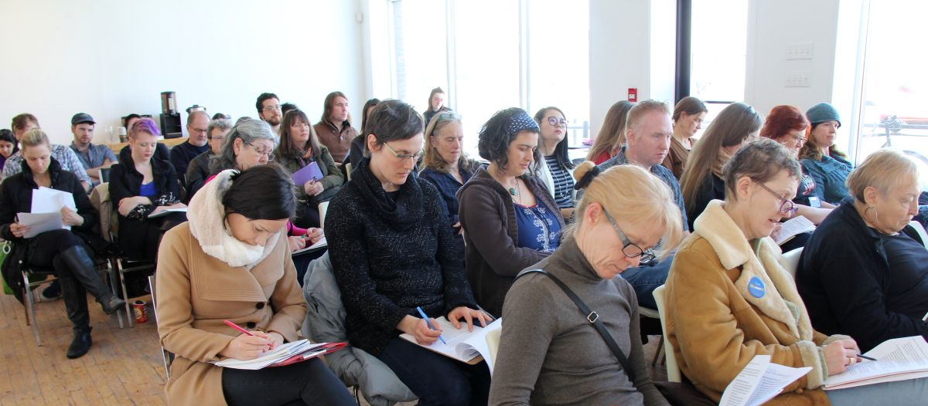
A multidisciplinary, multi-platform event designed to support artists in a variety of disciplines to develop the skills and confidence necessary to apply for grants from both private and public funders. Learn where and how to start, ways to frame your work, ideas and artistic vision. Understand how juries work and how to deal effectively with support material. What to do if it’s a win, or if it’s a No. Catch up on the changes at both CC and OAC. This event is perfect for the first timer or those who want to brush up their skills and increase their chances for success.

Slide 26
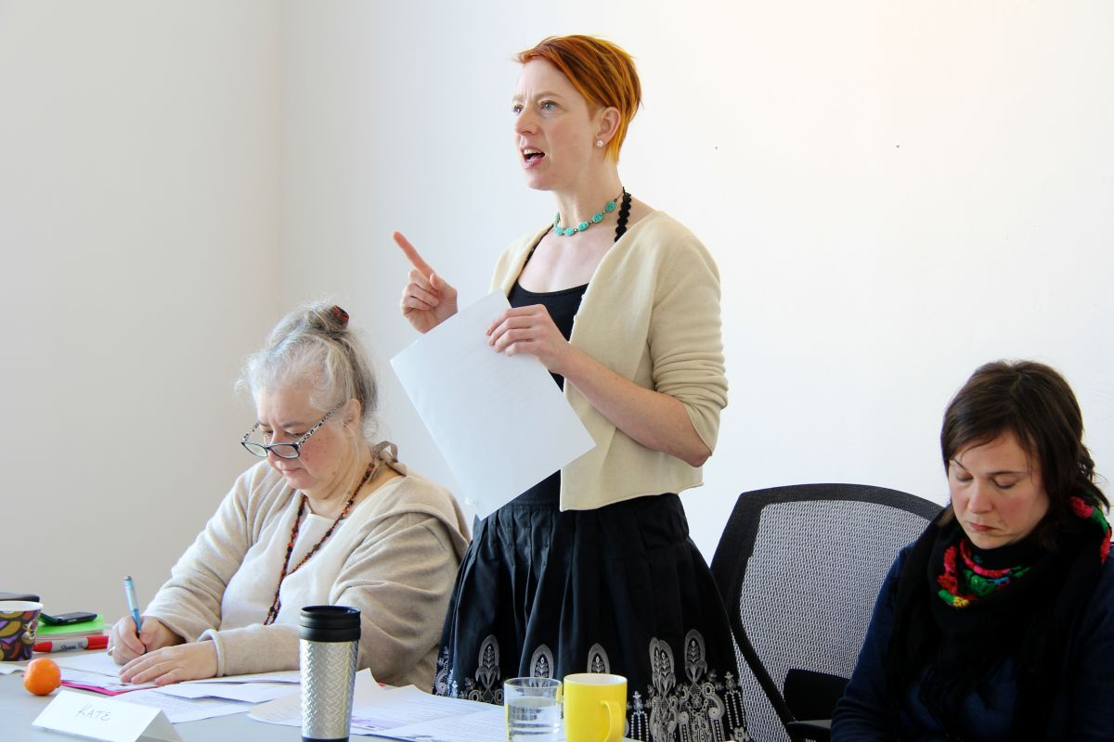
A panel of experts with practical knowledge, insight and experience to share with other Peterborough artists (they know how it feels and they have meaningful expertise to share). An opportunity for you to discuss a proposal one - on - one with a specialist in your discipline, watch the OAC “how to videos” with your peers, and be selected to take part in a mentorship program that will help you take your next grant application from start to finish.
Electric City Culture Council 2017
Annual General Meeting

Slide 27
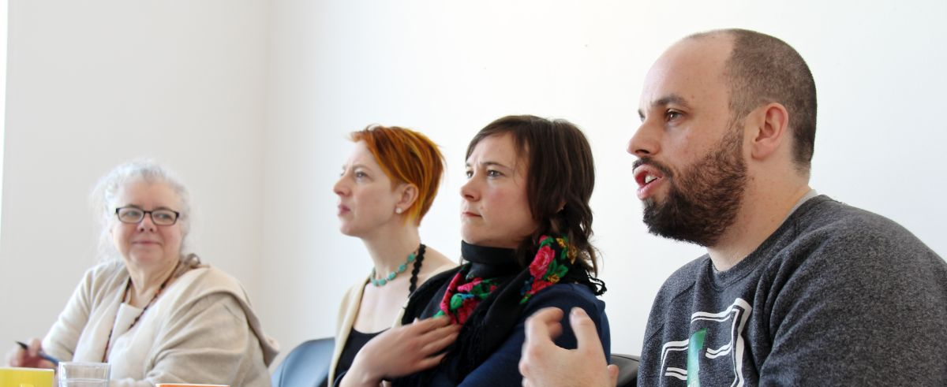
FEATURING:
Kate Story (writing, dance, theatre, multi-disciplinary)
Nick Ferrio (contemporary music)
Su Ditta (media arts)
Carolyn Code (visual arts)

Slide 28
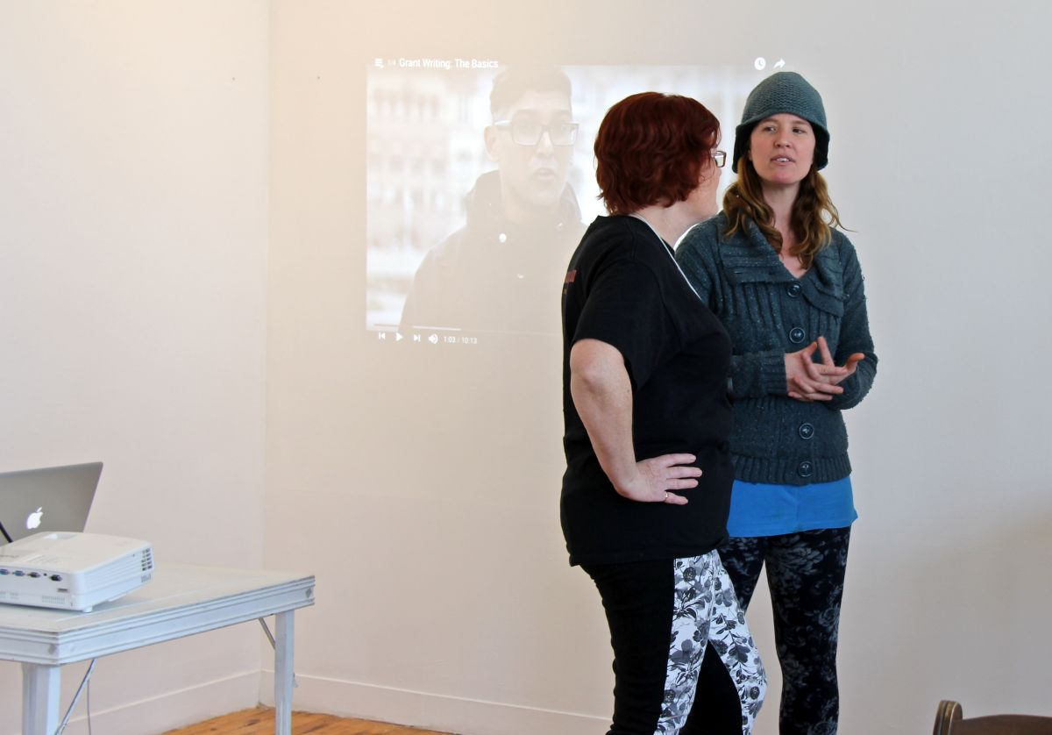

Slide 29
GRANTWRITING 2.0 MENTORSHIP PROGRAM
A one-on-one support program with artists and peer experts that took a project from conception to final grant application. It also provided some training for mentors.

Slide 30
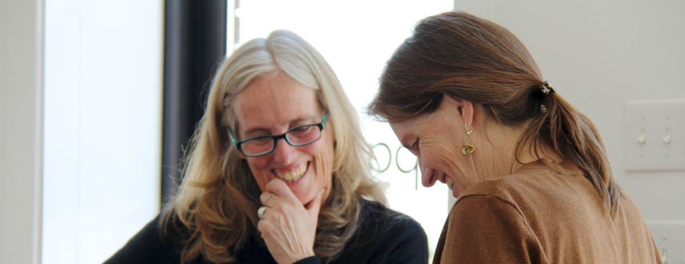
Mentors/Mentorees
Kate Story/ Elisha Rubacha
Nick Ferrio/Jill Stavely
Carol Code/Joellen Brydon
Su Ditta/Ayesha Barmania
MENTORS/MENTOREES
Kate Story/ Elisha Rubacha
Nick Ferrio/Jill Staveley
Carol Code/JoEllen Brydon
Su Ditta/Ayesha Barmania

Slide 31
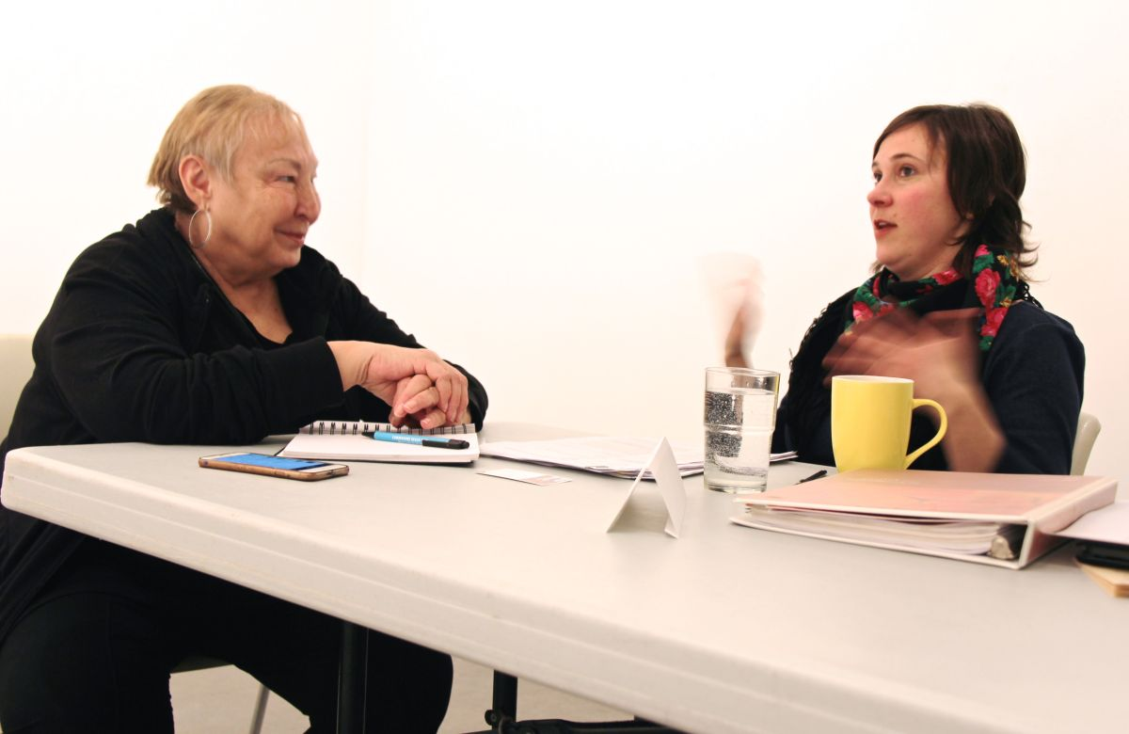
“This workshop spoke to artists as artists.
People shared and treated eachother as equals.
A perfect refresher.” JoEllen Brydon

Slide 32
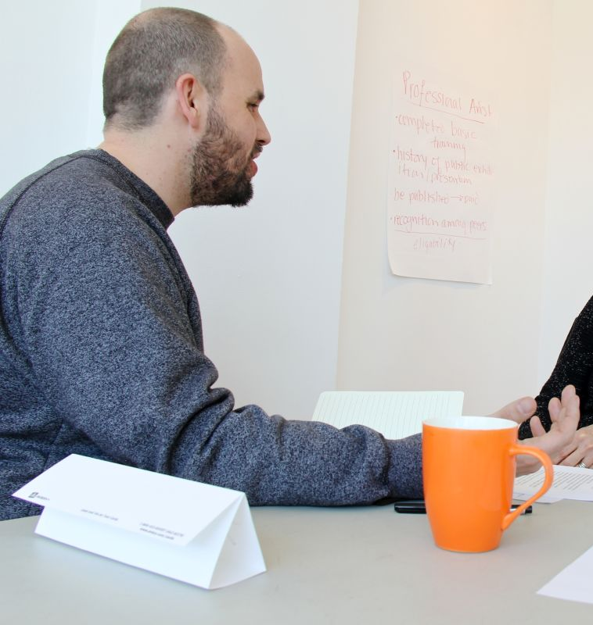
“I am writing to say thank you for the incredible opportunity of working with Nick Ferrio to prepare my first personal grant application since 2007. I just submitted my application to the OAC Music Creation Grant moments ago.”
“It has been very helpful to have Nick's succinct and supportive feedback during this process, and the encouragement to actually follow through with the process. I don't think that I would have completed the application without this opportunity.
The work you are doing for our community is very important and has positive outcomes in the way we build networks that support each other as active artists who strive to achieve great things within the landscape of Peterborough.
Regardless of the outcome - this process has had a huge impact on the way I view myself as an artist, and has helped me understand the hurdles that stand in my way from actively pursuing my artistic goals.” Jill Staveley

Slide 33
Cultural Incubators 2017
Michelle Berry and Michael Peterman: Art Matters
We Can Do Better Together: Trans & Gender Non-Conforming Artists in Peterborough/Nogojiwanong/ Intersectionality and Accessibility
A Space for Us: Reimagining the Downtown
Maawanji’idiwag – They Come Together
New Visions / Old Land Reprise: Troubling Canada 150: Screening and Panel, Podcast and Publication Launch
WORK: WORK: WORK: Uncertainty and Precarity in Creative Labour

Slide 34
Michelle Berry and Michael Peterman: Art Matters
Cultural Incubator: December 5th 2016
Author and Hunter St. Books owner Michelle Berry in conservation with Trent Professor Emeritus Michael Peterman on the creative process and her decision to open an independent bookstore in the heart of Peterborough’s downtown.

Slide 35
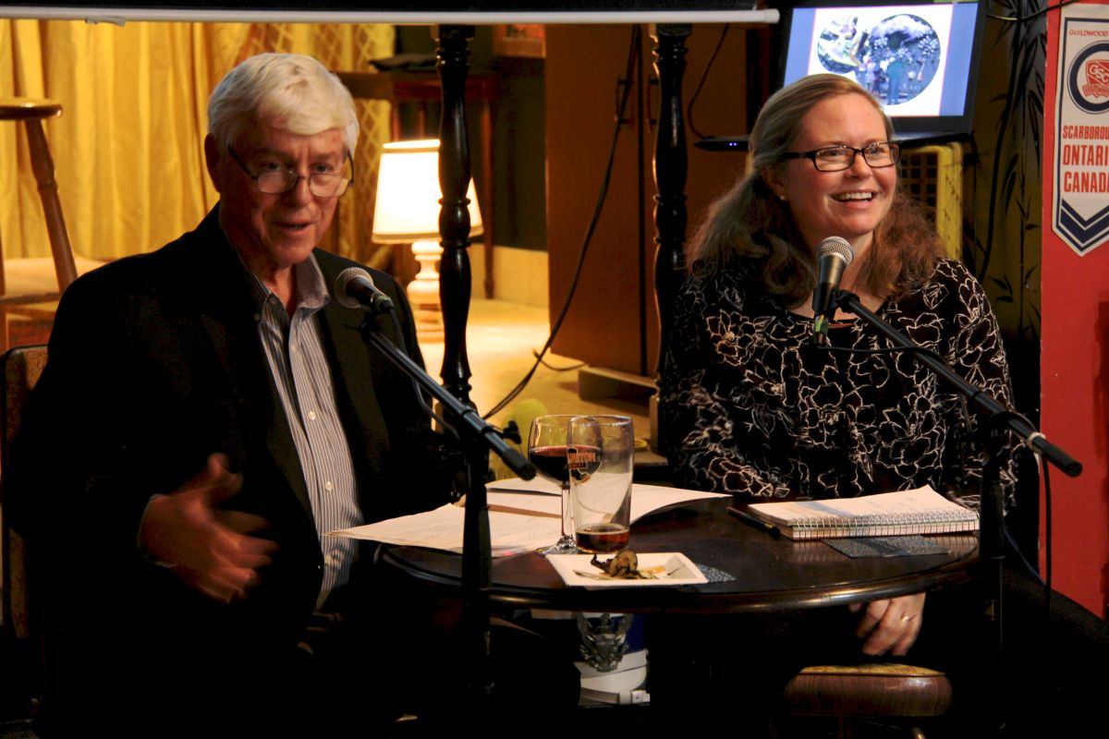

Slide 36
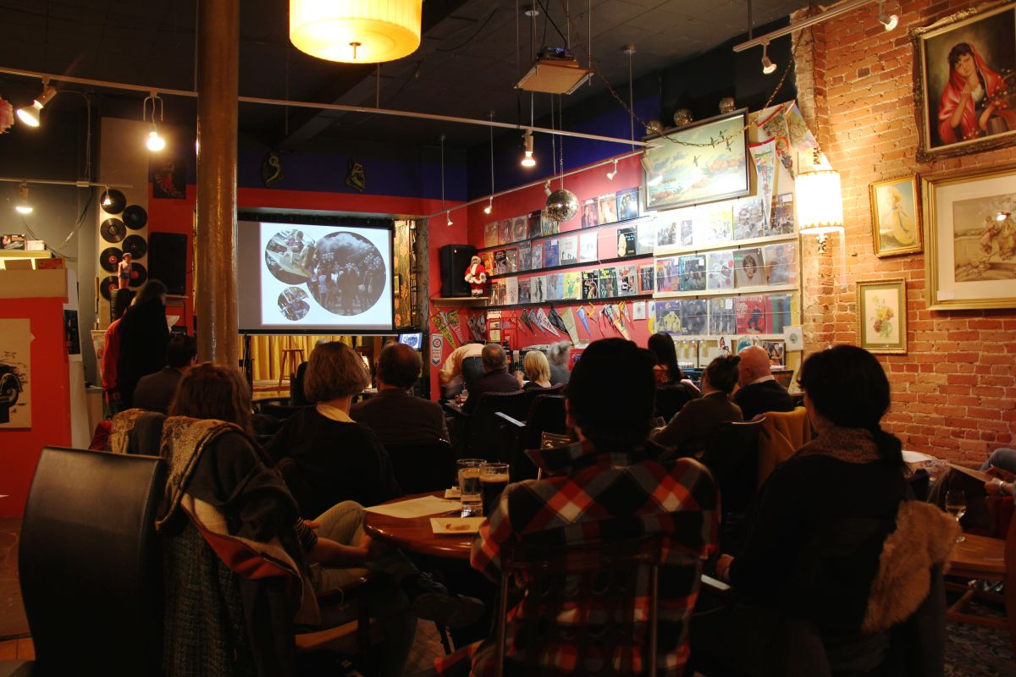

Slide 37
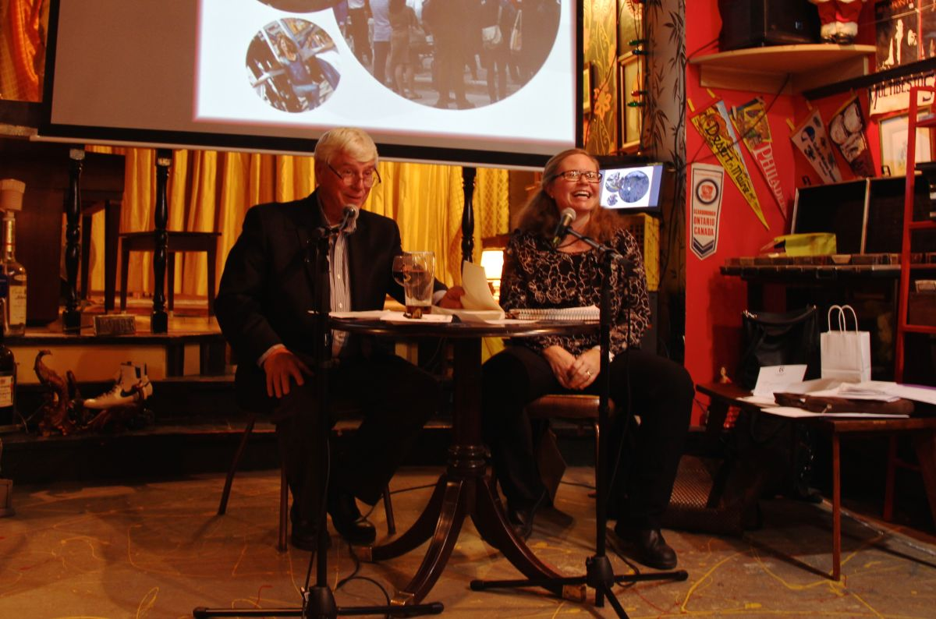

Slide 38
Electric City Culture Council 2017
Annual General Meeting
Cultural Incubator: March 25 2017:
In partnership with Public Energy
Moderator: Charlie Petch Panelists: Angela Semple, Evan Gentle, Scarlett Palmer, Niambi Leigh

Slide 39
Electric City Culture Council 2017
Annual General Meeting
A panel discussion with local artists, moderated by theatre artist, writer and performer Charlie Petch. What is the experience of trans and gender non-conforming artists in Peterborough/Nogojiwanong? What spaces and organizations feel welcoming? What are the particular challenges faced by trans and gender non-conforming artists? How do we work together to make spaces and organizations more inclusive? How can Peterborough lead by example? Are we accessing all the audiences we can? How can we do better together? This panel aimed to create dialogue around how we can increase diversity and nurture new audiences.

Slide 40
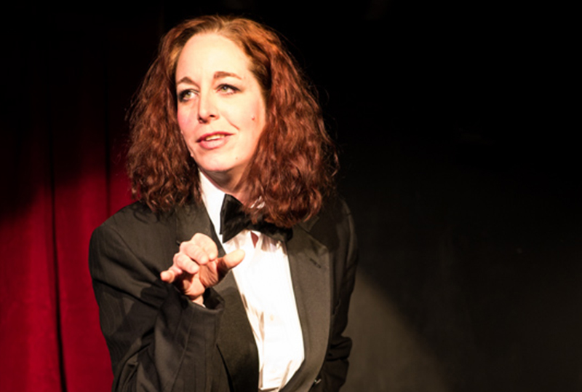
Participant surveys:
“It’s so important to create spaces for these discussions.”
“It’s always an important conversation to have!”
“The discussion made me feel comfortable and welcome”
Electric City Culture Council 2017
Annual General Meeting

Slide 41
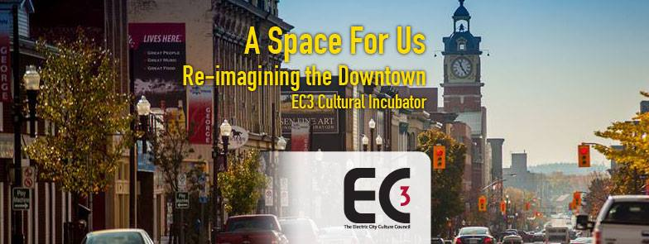
Annual General Meeting 2017
Cultural Incubator: June 1 2017
Panel Discussion
Moderator: Michael Gallant (EC3/Lett Architects)
Panelists: Jeremy Freiburger (COBALT Connects), Laurel Paluck (Atelier Ludmila), Catherine Nasmith (President Architectural Conservancy Ontario).

Slide 42
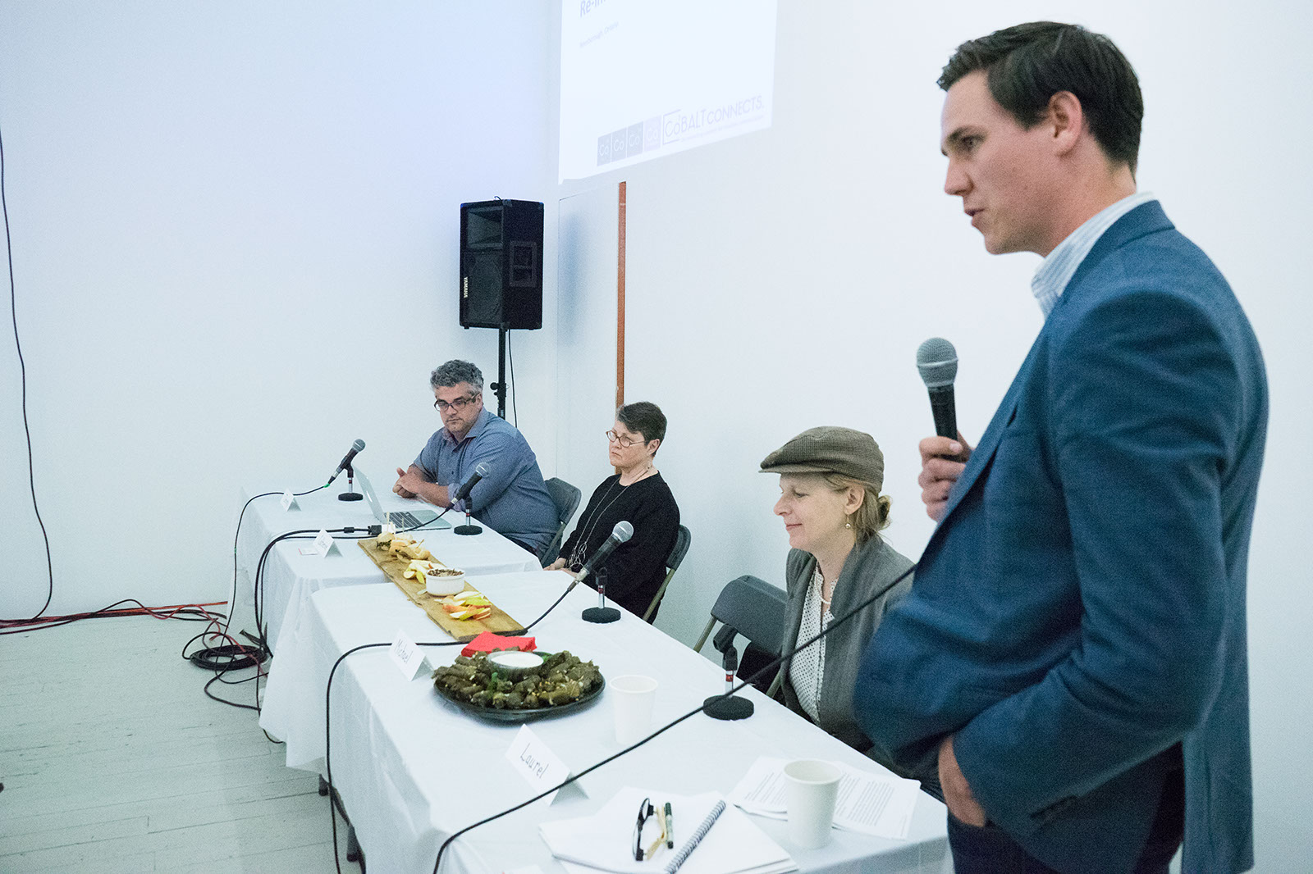
This panel explored the issues swirling around recent controversies in Peterborough’s unique heritage downtown and the impact on artists, artmaking and cultural community development including: preservation, conservation, densification and gentrification.

Slide 43
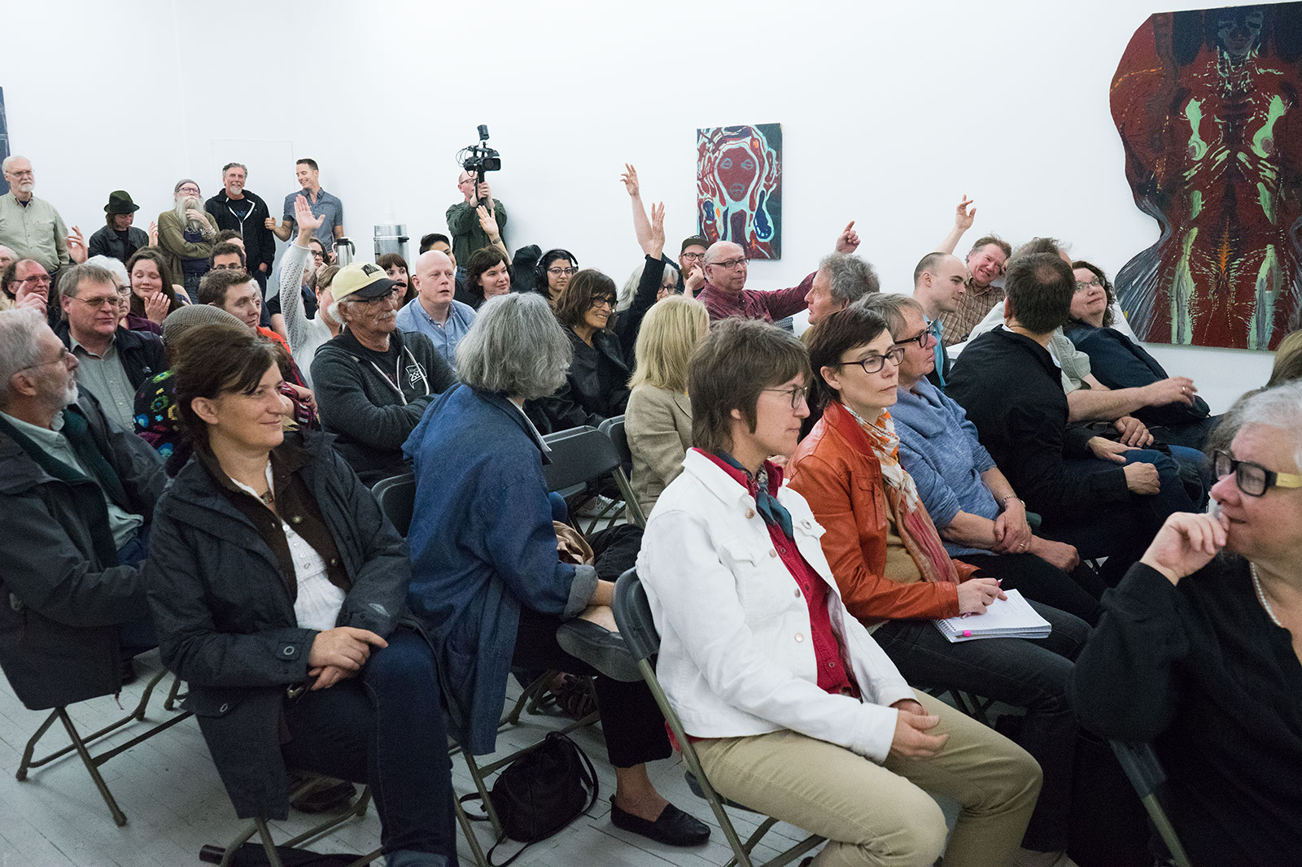

Slide 44
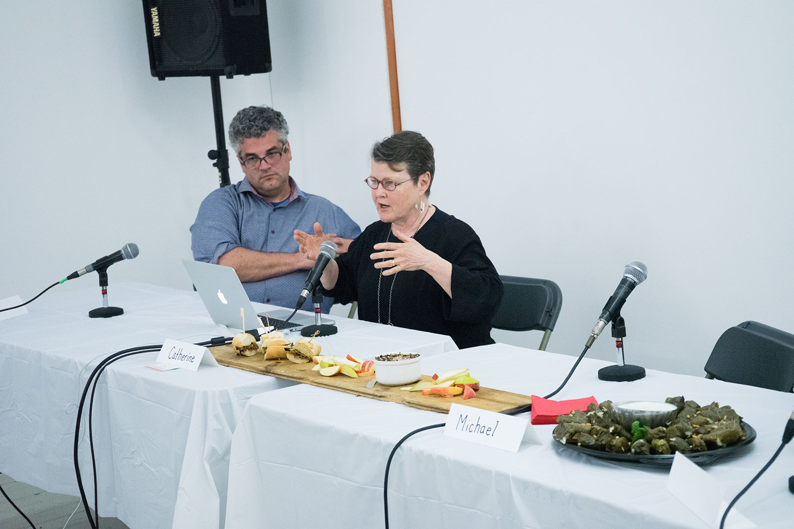

Slide 45
Maawanji'idiwag: They Come Together
Cultural Incubator: July 12 2017
In Partnership with Artspace
Panel Discussion: Talk and sharing with William Kingfisher, Dylan Miner, Thomas Olszewski, and Olivia Whetung exploring issues of territory, community and boundaries. Followed by a community feast.

Slide 46
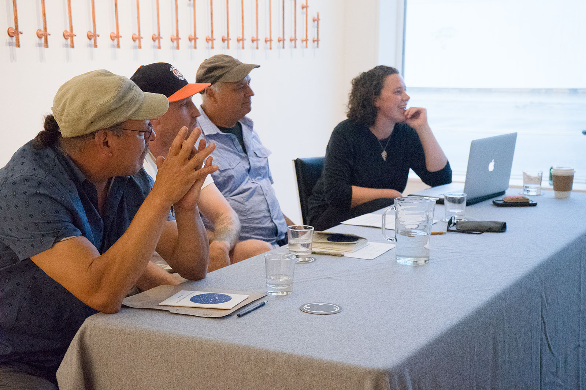

Slide 47
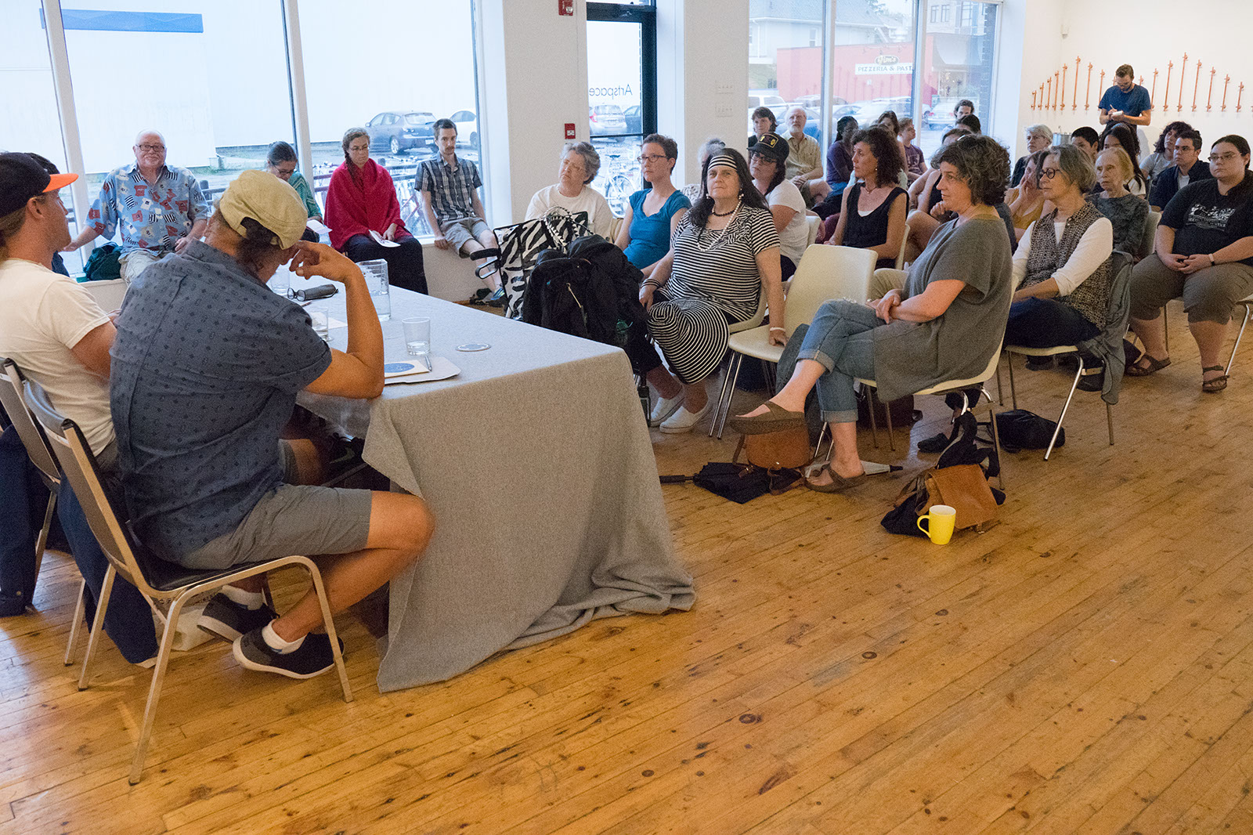

Slide 48
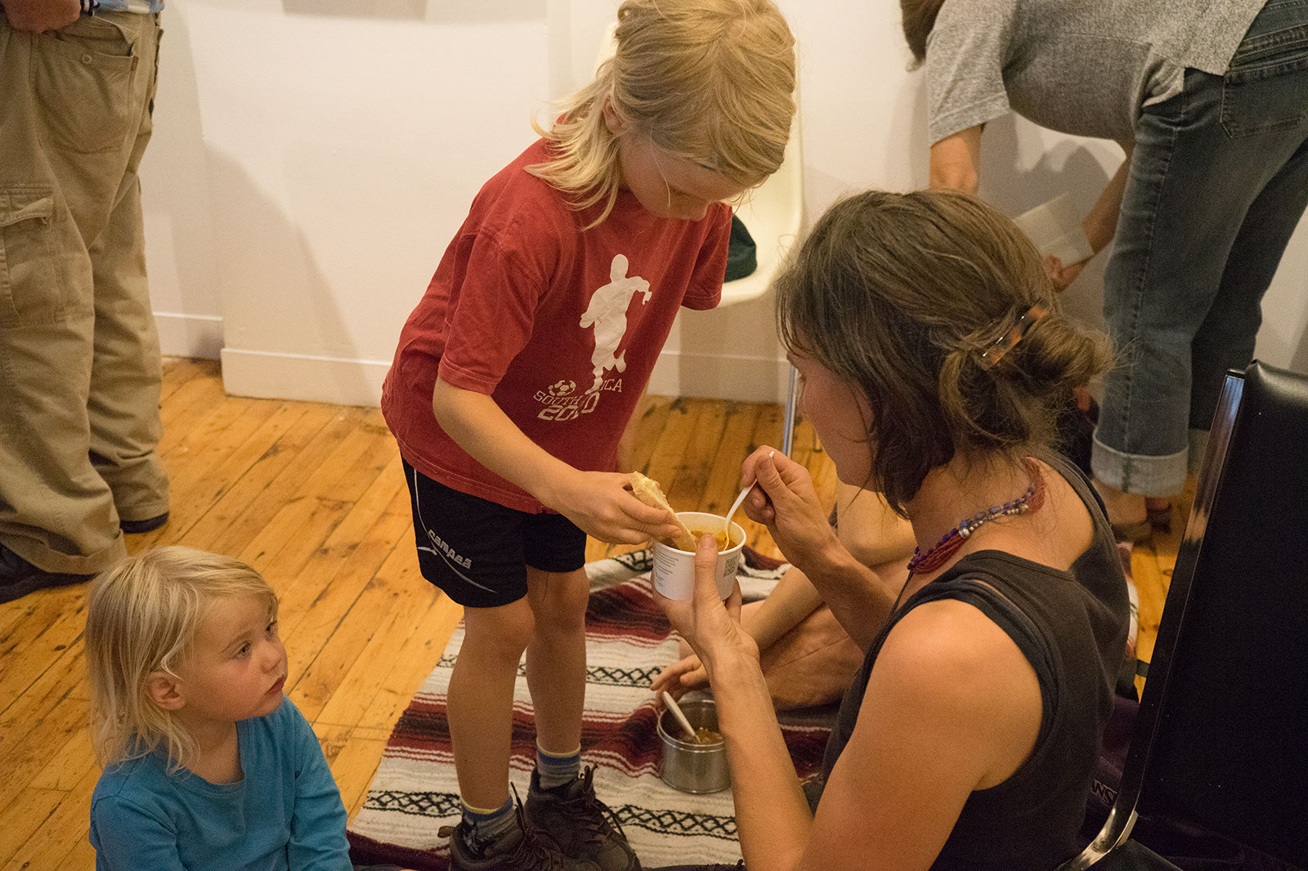

Slide 49
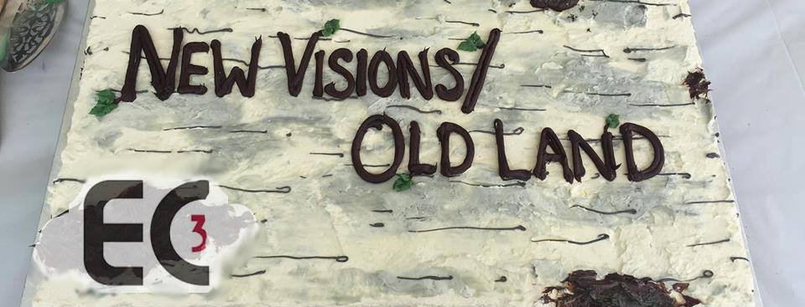
Reprise: Troubling
Canada 150
Cultural Incubator: New Visions / Old Land Reprise: Troubling Canada 150:
September 30 2017
Exhibition, Screening, Panel, Podcast and Publication Launch

Slide 50
Featuring: Filmmakers Cara Mumford, Joeanne Argue, Shannon Taylor, Kerri Kennedy Meagan Christou and NV/OL curator Kelly Egan.

Slide 51
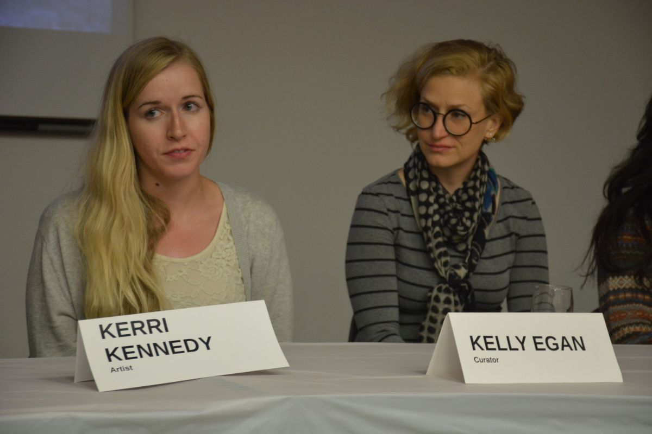
Canada 150 was a vexed celebration to say the least. The artists and curator who created the New Visions/Old Land immersive exhibition on Hunter St. West for the July 1st long weekend, talk about the tensions and contradictions of working on that project and how they brought critical perspectives to light.

Slide 52
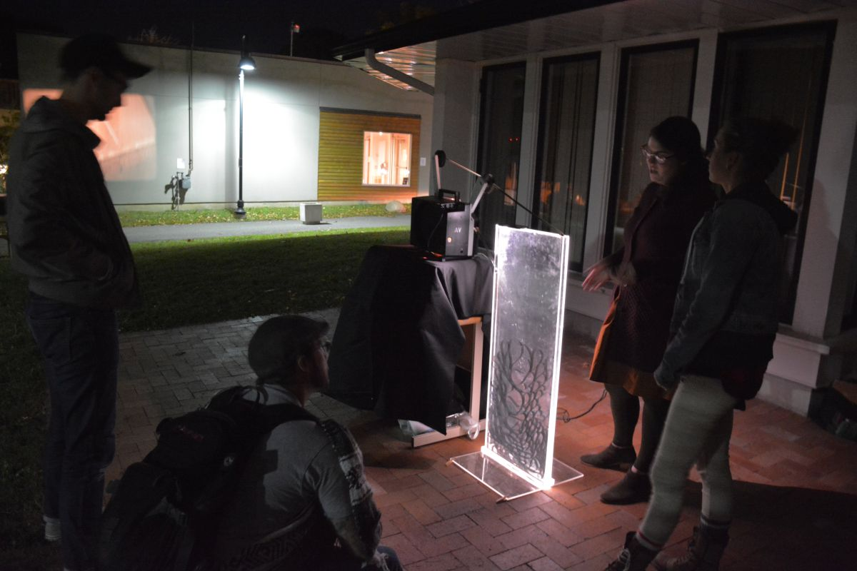

Slide 53
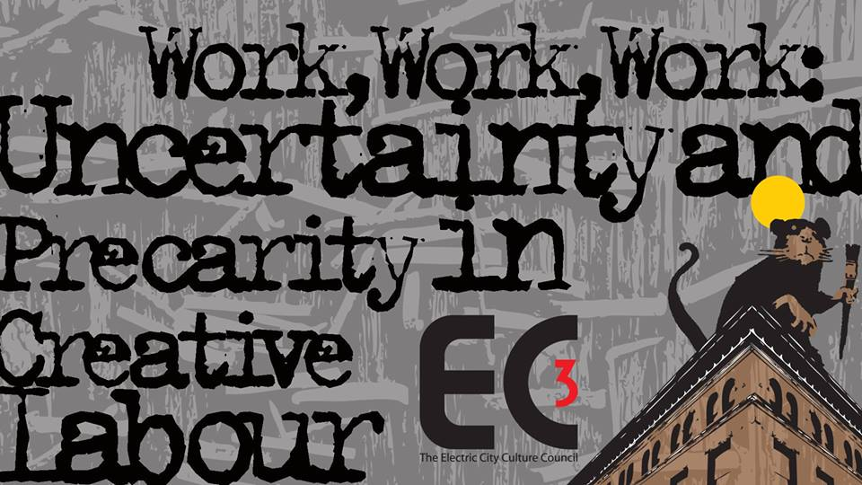
Cultural Incubator: November 10:
In Partnership with PRECARIOUS: Peterborough ArtsWORK Festival
Panel Discussion
Moderator: EC3 Executive Director, Su Ditta
Panelists: Craig Berggold, mental health advocate, therapist, and artist Brian Nichols, CAR/FAC Ontario Executive Director Sally Lee, and proud member of the Ktunaxa Nation and a PhD candidate in Indigenous Studies at Trent University -Smokii Sumac.

Slide 54
Precarious workers are those that fill permanent jobs but are denied permanent employment rights. Why is so much creative labour precarious? What are the consequences of increasing precariousness for work of all kinds, across the board? How does precarity impact art practice and our cultural experiences and environment? EC3 and the Precarious Festival presented this panel discussion on the social and economic realities of contemporary arts creation, production and presentation; including the impact of labour market/employment precarity, changing funding models, copyright, gentrification, cultural appropriation, stress and mental health challenges.

Slide 55
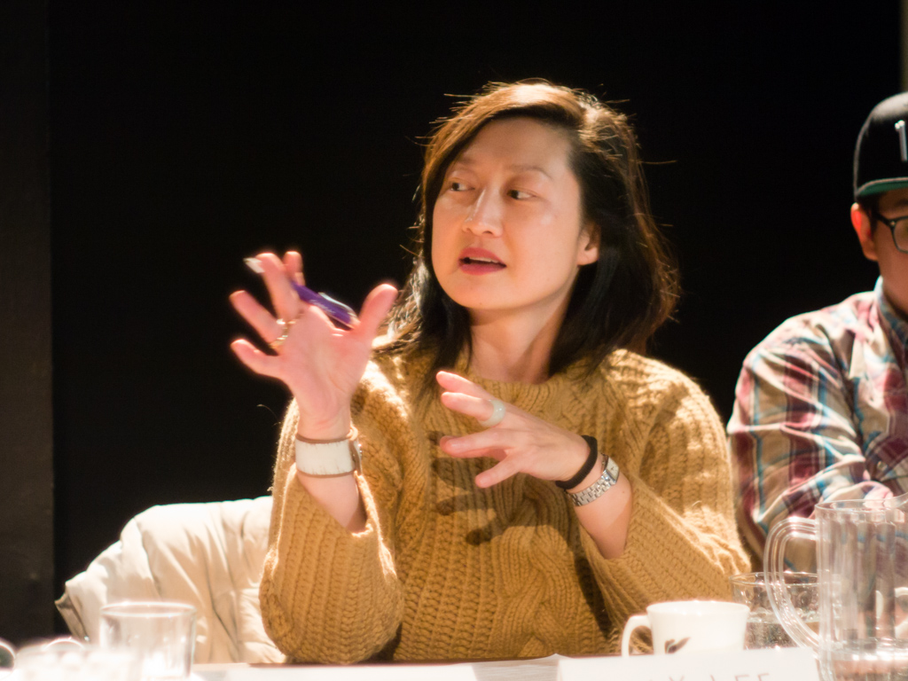
“Precarity is a precarious existence, lacking in predictability, job security, material or psychological welfare. The social class defined by this condition has been termed the precariat.”
- Wikipedia

Slide 56
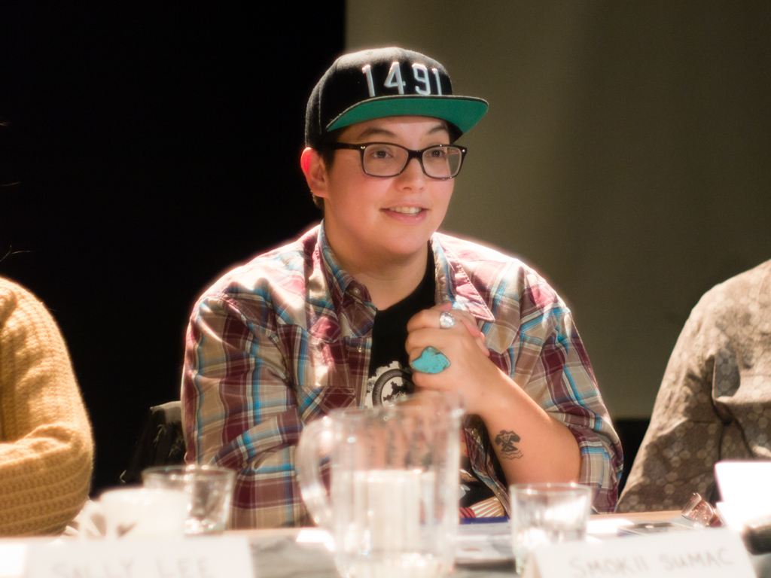

Slide 57
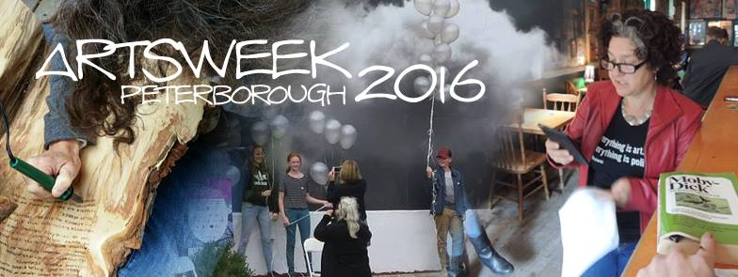
Artsweek: A Biennial Festival
September 20 – September 30 2018
Program Assessment and Review
Artsweek Reorganization
Artsweek Applications: January 3 2017
Artsweek Public Information Session: December 14 2017
Artsweek Artistic Producer: Bridget Love

Slide 58
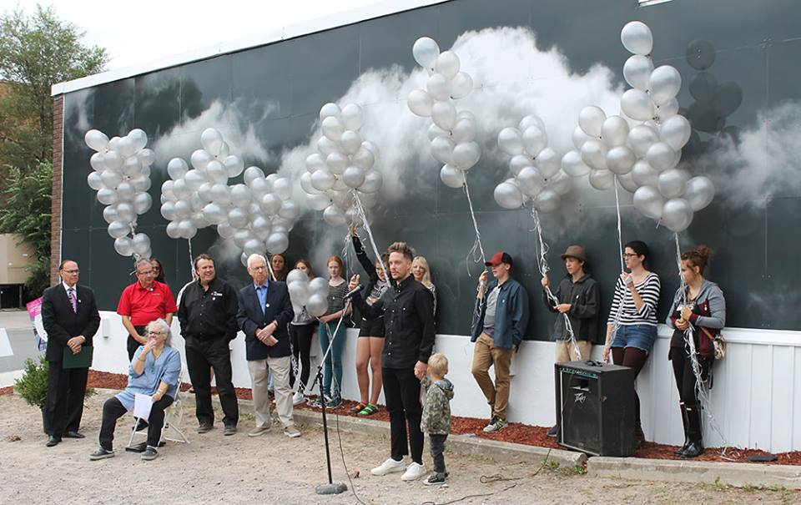

Slide 59
Special Projects
New Visions/Old Land: Canada 150 Project on Hunter St. /June 30 Media Arts Exhibition and Broadcast
Arts Awards and Mayor’s Luncheon for the Arts: May 25th 2017, MSAC
CFGP: Bierk Art Fund Bursaries Project
Downtown Artists in Residence Program
Kawartha Youth Orchestra Commissioning Program
Status of the Artist in Peterborough Project: Survey and Report

Slide 60
June 30 2017
Partners: Public Energy and Artspace
Commissioning of 4 silent films and live musical/soundscape accompaniment.
Curator: Kelly Egan
Artists: Meagan Christou, Kerri Kennedy, Shannon Taylor, Cara Mumford/Joeann Argue, Benj Rowland, Nick Ferrio, Andrew Savery Whiteway.

Slide 61
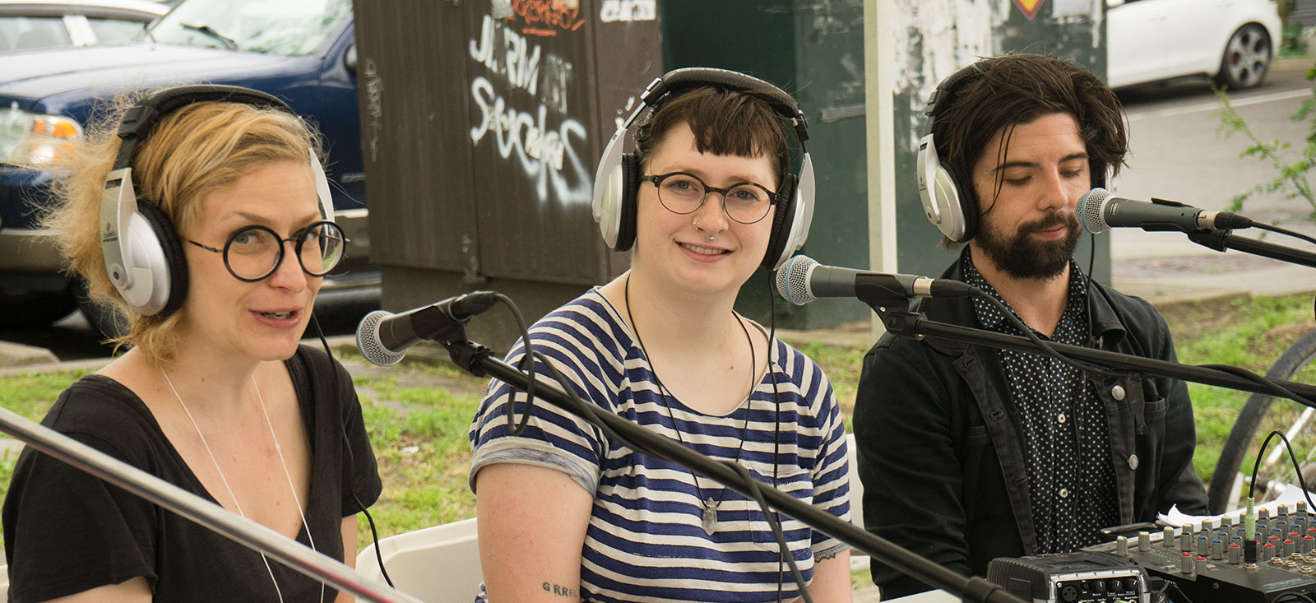
Curator Kelly Egan created a spectacular multi-media environment with 4 pop-up theatres, store front screenings, a live, remote Trent Radio broadcast and a camera-less filmmaking workshop for kids right on Hunter St. West.
Technical Production: Steve Rose/UNAVOX

Slide 62
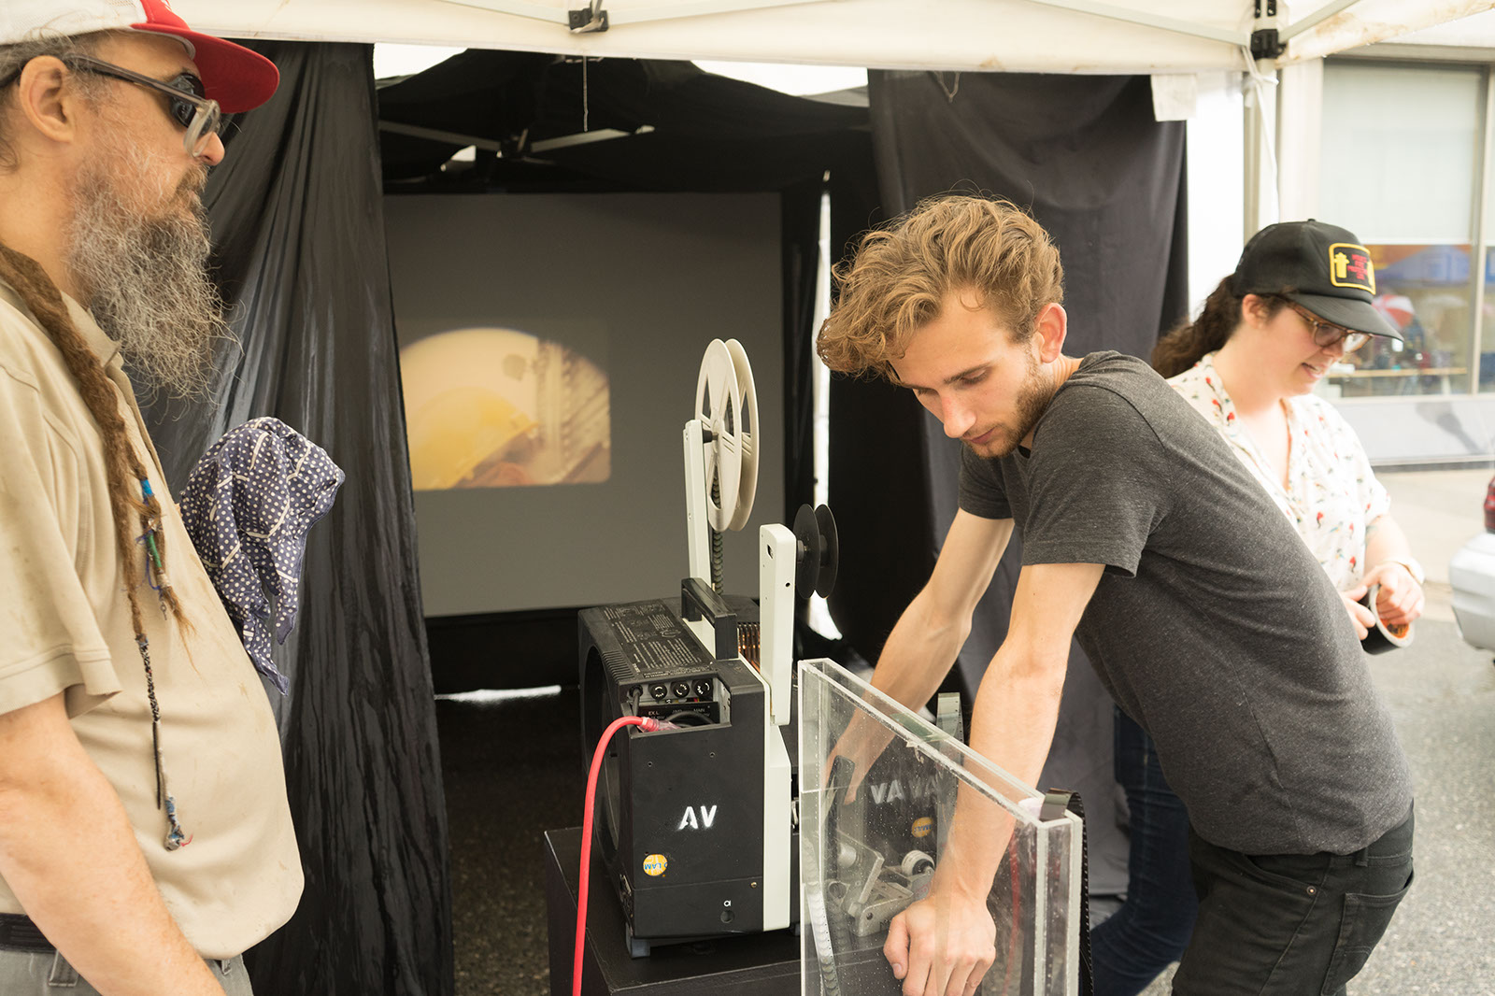

Slide 63
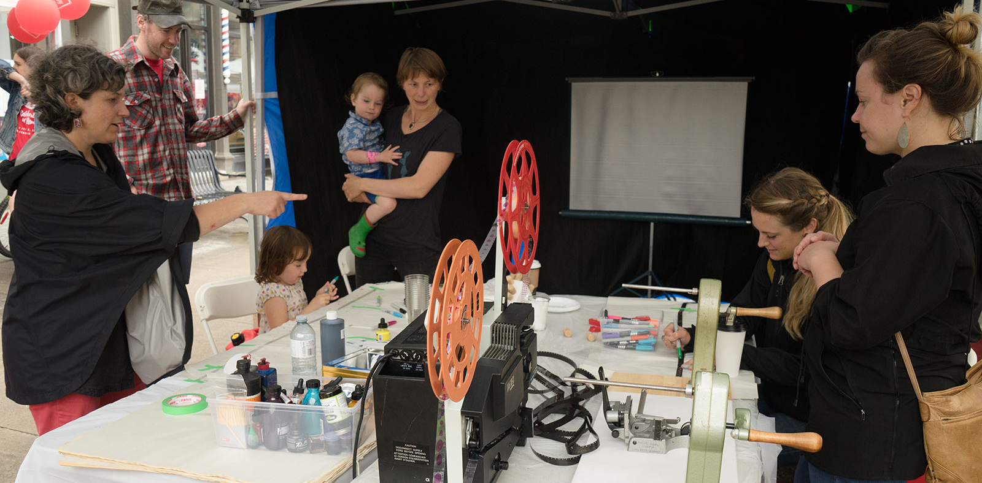
Special thanks to: Hunter St. Books, CIBC, Toy Shop, Meta4, Sam’s Deli, and Leslie Menagh

Slide 64
May 25, 2017,
McDonnel Street Activity Centre

Slide 65
EC3 Arts Awards and the Mayor’s Luncheon for the Arts
Peterborough’s inaugural Arts Awards program!!
Guest Speaker Wanda Nanibush: Curator of Indigenous Art at the Art Gallery of Ontario
5 prizes of $2,000 each:
Emerging Artist
Mid-Career Artist
Senior Artist
Indigenous Artist
Arts Champion

Slide 66
Bierk
+ Art +
Fund
Bursaries Project
May 25 2018
Four new $500 bursaries will be presented to Peterborough students graduating from high school to pursue art education at the post-secondary level. Thanks to the AGP as well for their support of this project. Bursaries will be awarded at the Mayor’s Luncheon for the Arts, along with the Arts Awards.

Slide 67
Downtown Artists in Residence Program
A new program:
Three artists will receive residencies in downtown storefronts for 1 month.
Artist fee and space provided along with curatorial support and marketing and communications support. Further details TBA.

Slide 68
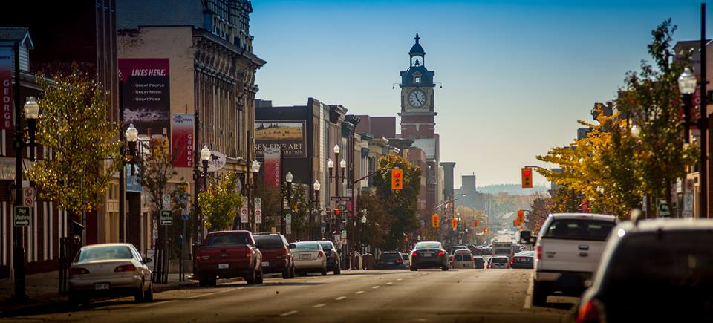

Slide 69
Kawartha Youth Orchestra Commissioning Program
EC3 and the Kawartha Youth Orchestra are partnering to commission an additional three new compositions from KYO members. Musicians will compose theme music for the Electric City Cuturecast and record for broadcast in the studios of Trent Radio.

Slide 70
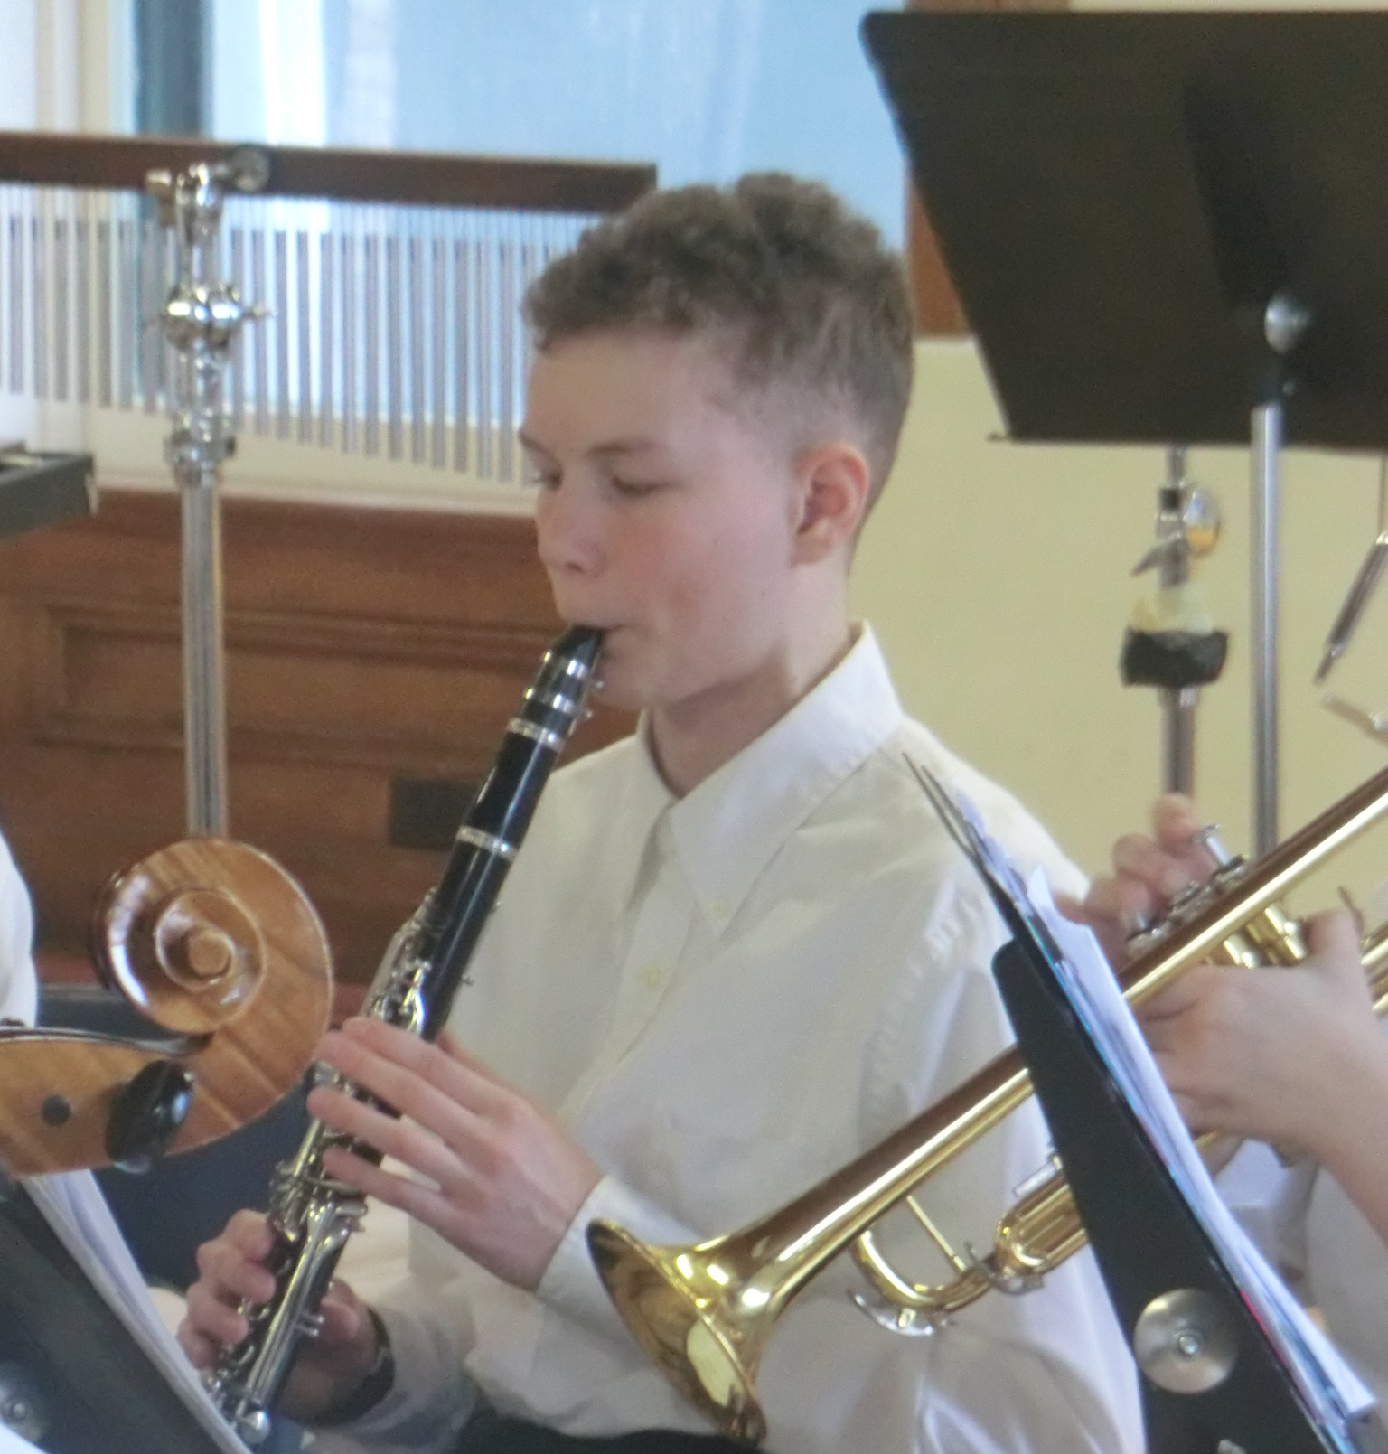

Slide 71
Status of the Artist in Peterborough Project: Survey and Report
The Status of the Artist in Peterborough Project
Knowing and understanding what life is like for professional artists in Peterborough is critical to making things better. The Electric City Culture Council (EC3) and the Precarious Festival have joined forces to undertake Peterborough’s first ever investigation of the social and economic conditions that impact local artists and their work.
This is a partnership project organized with the support of the Trent Community Research Centre and researcher Trent Sustainability Studies Masters student, Anna Currier. This project includes a survey, background research and analysis and a final report presented at an EC3 Cultural Incubator in the Spring.

Slide 72
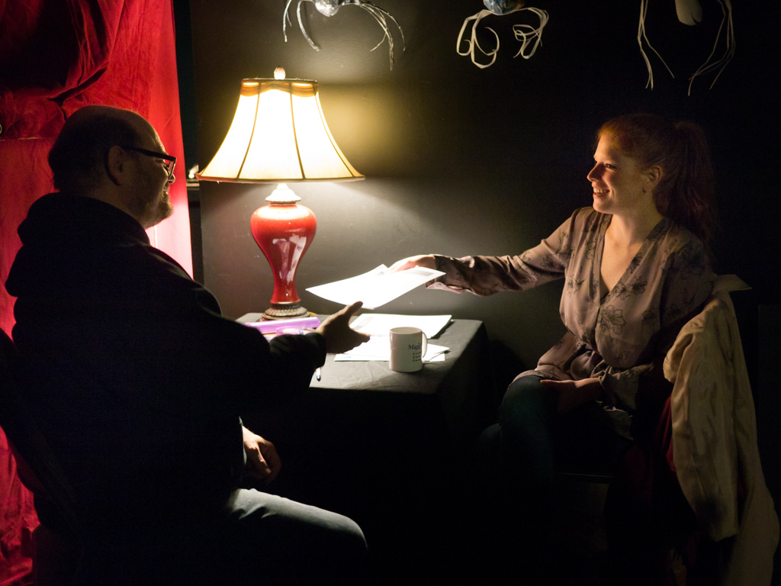
Thanks to: Kate Story, Anna Currier, John Maris, Dave Tough, Professor Colleen O’Manique and Jeff Macklin for their support of this project.

Slide 73
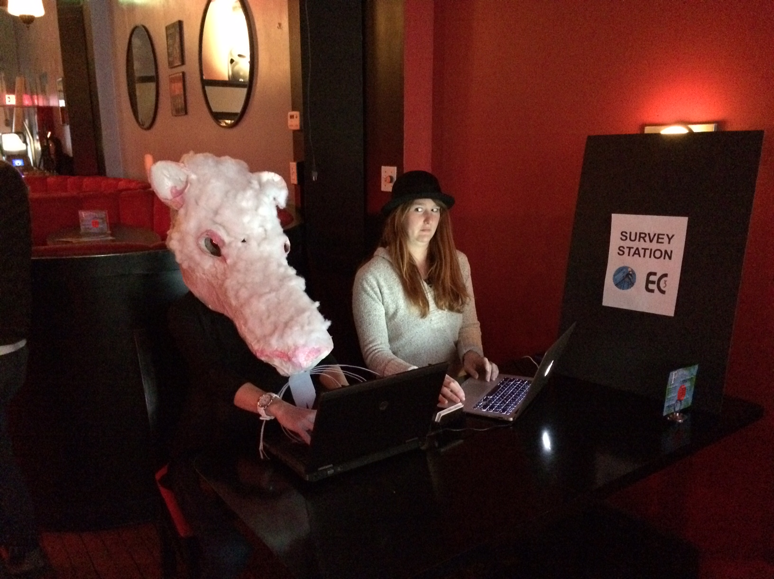
If you haven’t filled out a survey yet, go to ecthree.org or fill out a survey here tonight!

Slide 74
EC3 Programming Coming Up Soon
EC3 has lots of great programming in development for 2018

Slide 75
Cultural Incubators
Margie Zeidler on saving 401 Richmond
Eric Hanson on the Heritage Registry and PACHAC
Thinking About the Official Plan with Reimagine Peterborough
Money, who has it and how to get it. Funders Forum
Arts Vote Peterborough

Slide 76
Professional Development Workshops
Territorial Land Acknowledgements: Protocols and Performance
Governance for Arts Not-for-Profits: Diane Lister
Applying for Public Art CFP’s and Commissions
Multi-disciplinary Grantwriting for Indigenous Artists
Contemporary Music Funding Opportunities and Skills Development in Partnership with Trent Radio
Multi-Level Exhibition Application and Portfolio Development in partnership with AGP
Relaxed Performances in partnership with SHOWPLACE? and others

Slide 77
Marketing and Communications
Annual General Meeting 2017

Slide 78
Outreach Projects
Cultural Mapping and Outreach Research Project
Electric City Culturecast: Episodes. 1 – 5 (Broadcasts and Podcasts)
Cross Promotion Initiatives
Ad Campaign
Arts Awareness Initiatives

Slide 79
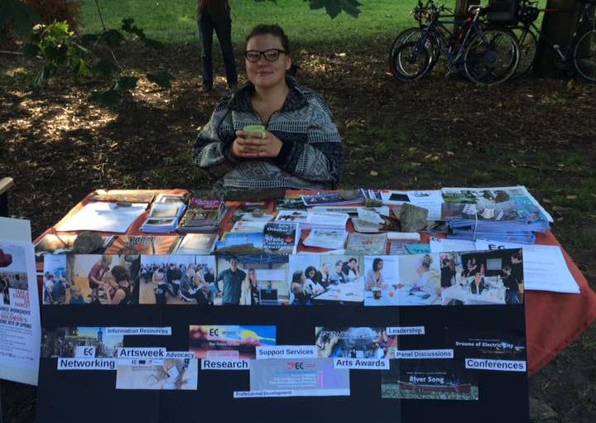
ARTS AWARENESS AND OUTREACH
This summer EC3 received a Canada Summer Student Job grant and hired Trent student Bronwyn Huggins. Bronwyn worked with our Program Coordinator Eva Fisher to update and expand our mailing lists, do some cultural mapping and develop outreach initiatives. Bronwyn collected season brochures and other information from many of Peterborough’s arts, culture and heritage organizations and created a booth representing our community for Trent’s Intro Week.

Slide 80
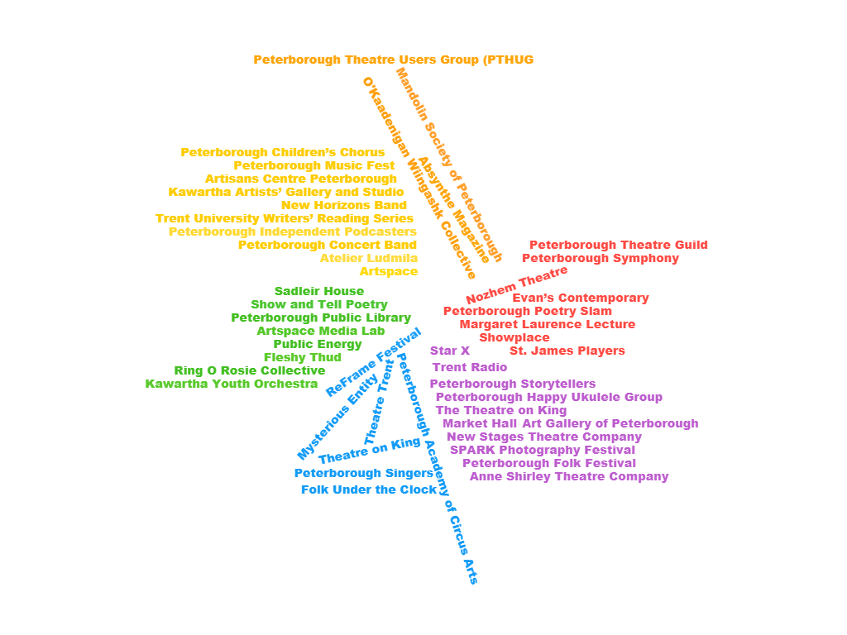

Slide 81
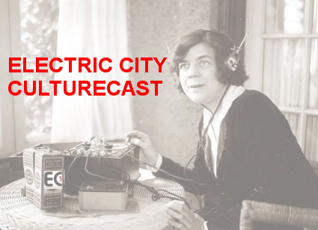

Slide 82
The Electric City Culturecast
A half hour radio broadcast, every other Wednesday night at 7:00 pm on Trent Radio at 92.7 FM on your radio dial. This magazine format show hosted by EC3 Executive Director Su Ditta and Program Coordinator Eva Fisher includes news, reviews and feature interviews with people in the local arts, culture and heritage scene, along with music, an advice column and cultural trivial quiz. It is also available by podcast through PIP (Peterborough Independent Podcasters).
This outreach and marketing initiative premiered in the fall and featured an exploration of organizations in town and at Trent who launch a full programming season in the autumn as well as highlighting some key events coming up. Look who’s been on the radio…

Slide 83
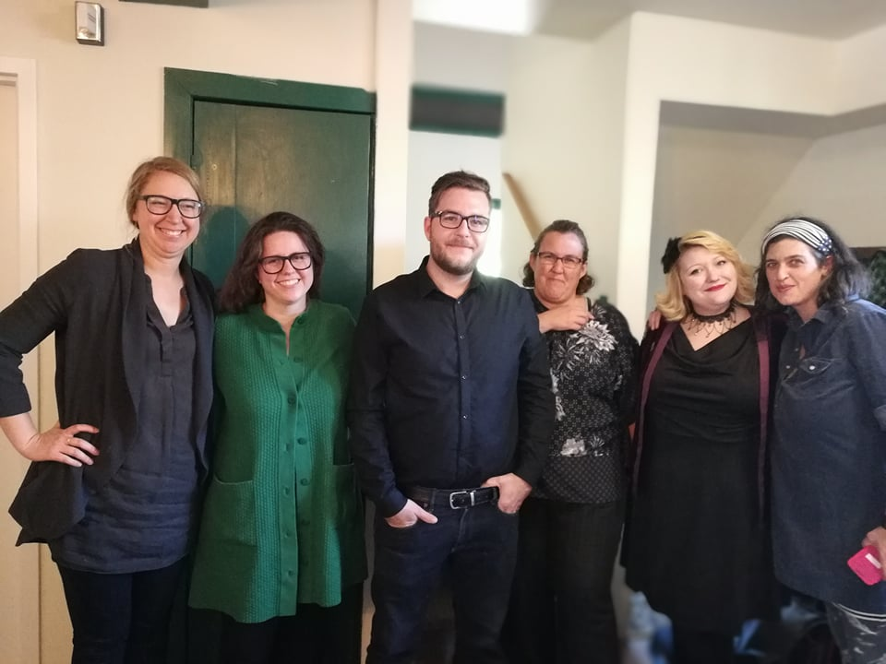

Slide 84
Electric City Culturecast Guests: Volumes 1-5
The Market Hall
Trent Valley Archives
Public Energy
Trent Film Society
The Peterborough Singers
Peterborough Symphony Orchestra
In From the Cold
Canadian Festival of Spoken Word

Slide 85
Electric City Culturecast Guests: Volumes 1-5
Artspace
Showplace
First Fridays
The Art Gallery of Peterborough
Precarious: Peterborough ArtsWORK Festival
Evans Contemporary
Christensen Fine Art
Trout in Plaid

Slide 86
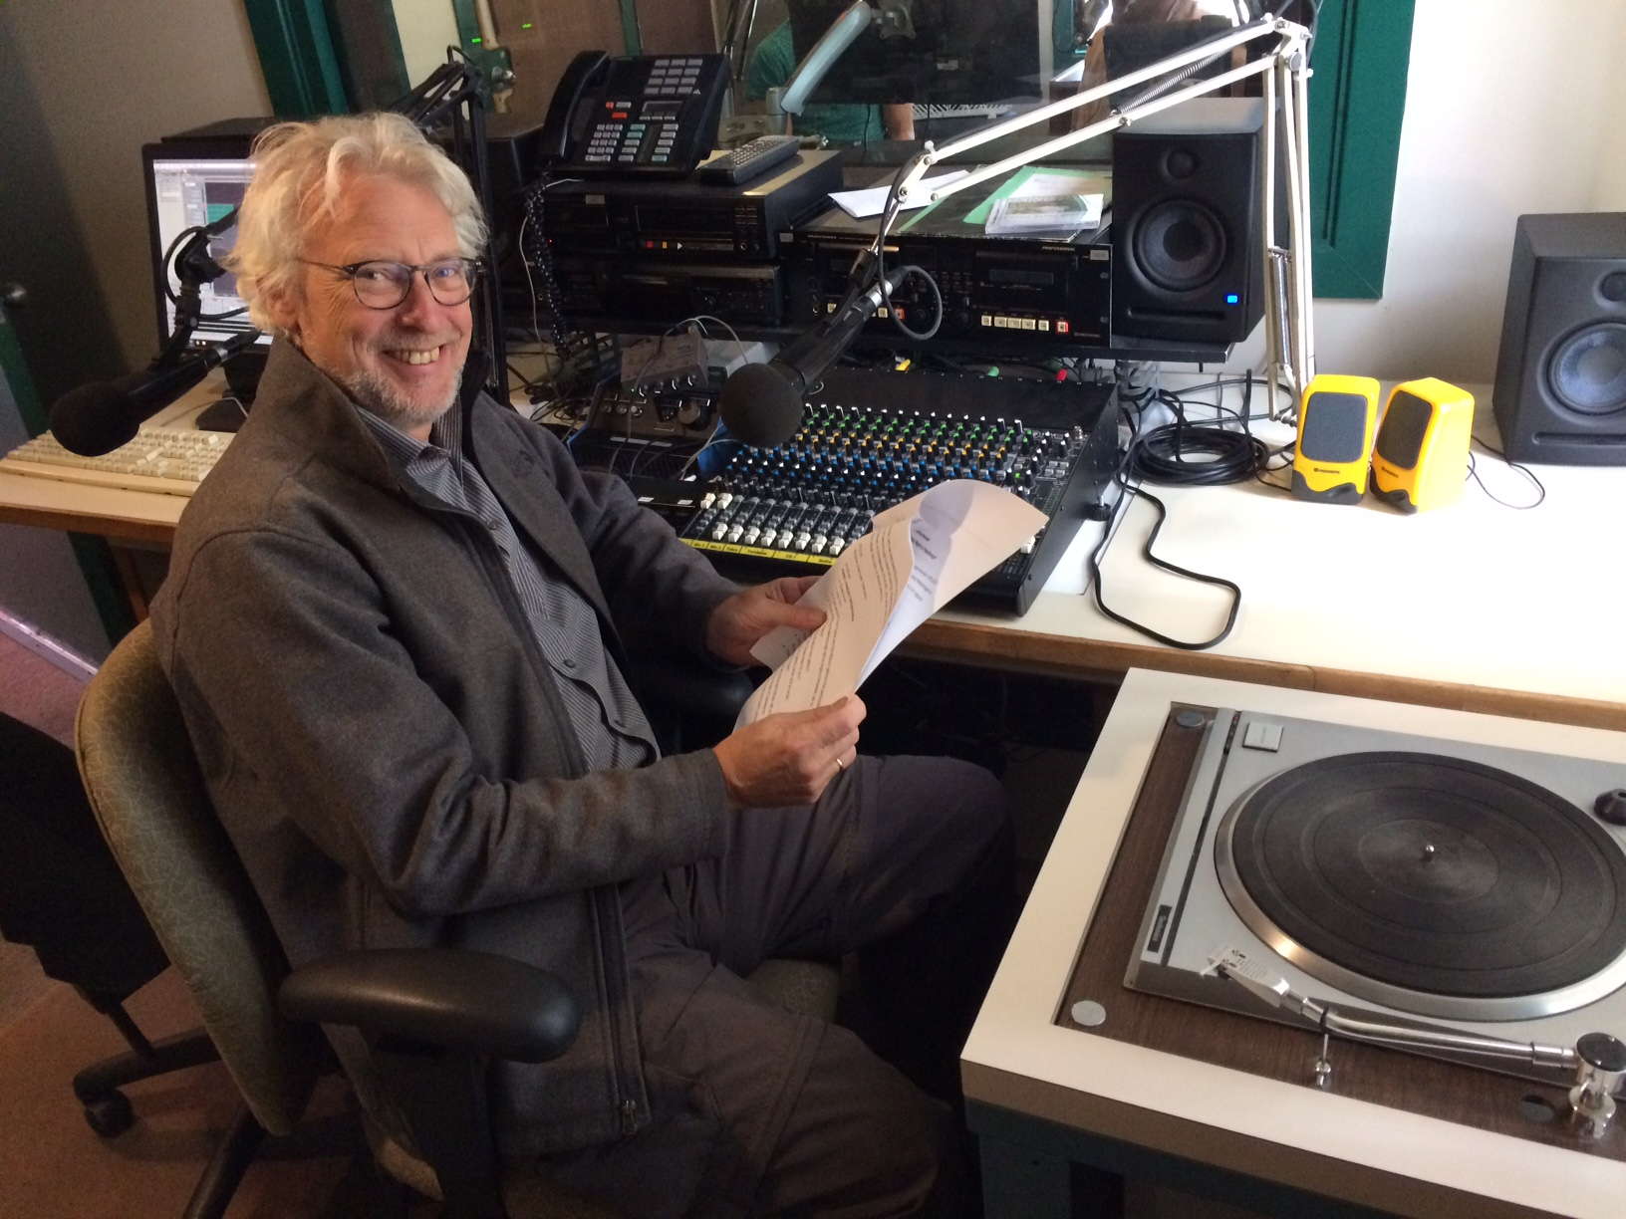

Slide 87
Research and Information Resources
Background reading, research, TOP TEN TIPS etc. posted on our websites for all projects

Slide 88
Advocacy and Strategic Leadership
Downtown Heritage Issues Campaign (Delegation, Letter Writing and Phone Calls)
ACHAC (Arts, Culture and Heritage Advisory Committee - City)
PAAC (Public Art Advisory Committee)
Community Investment Grants Budget Advocacy
DBIA Vibrancy Working Group
City Community Wellbeing Plan Advisory Committee
Maryam Monsef: SOCAD and Status of Women and Sub Committees
Ontario Arts Council Consultation
Ontarians For the Arts
Official Plan Advisory Committee

Slide 89
Strategic Ad Hoc Representation
City Rebrand
Downtown Property Tax Relief
Peterborough Public Library Strategic Plan Consultation
Peterborough Economic Development: Tourism Consultation
CFGP: Vital Conversations x 2

Slide 90
Concierge Support Services
The Peterborough Historical Society

Slide 91
Thank you SO much!
Staff:
Su Ditta
Executive Director
Eva Fisher
Program Coordinator
Sue Newman
Bookkeeper
Electric City Culture Council
Board of Directors 2017
Bill Kimball
President
Randy Read
Vice President
Yvonne Lai
Secretary-Treasurer
Michael Gallant
Sue McGregor-Hunter
Dave Tough
Nadine Changfoot
Jonathon Lockyer

Slide 92
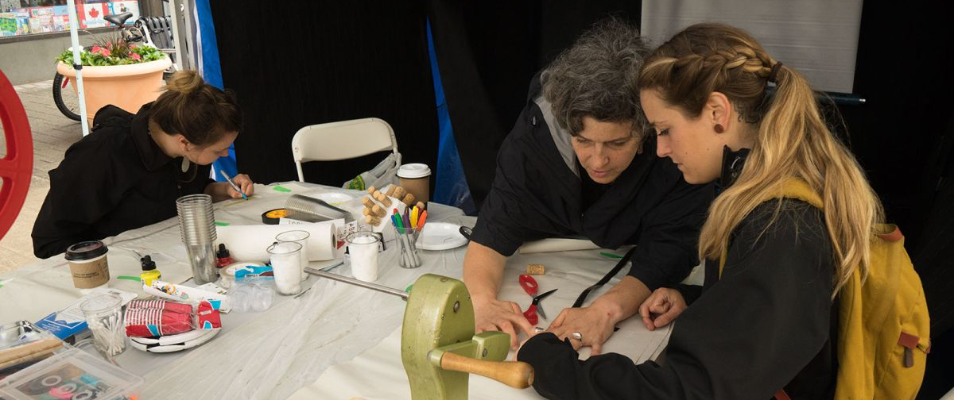
Thanks to our Volunteers,
We couldn’t do it without you!

Slide 93
Thanks to our Funders

Slide 94
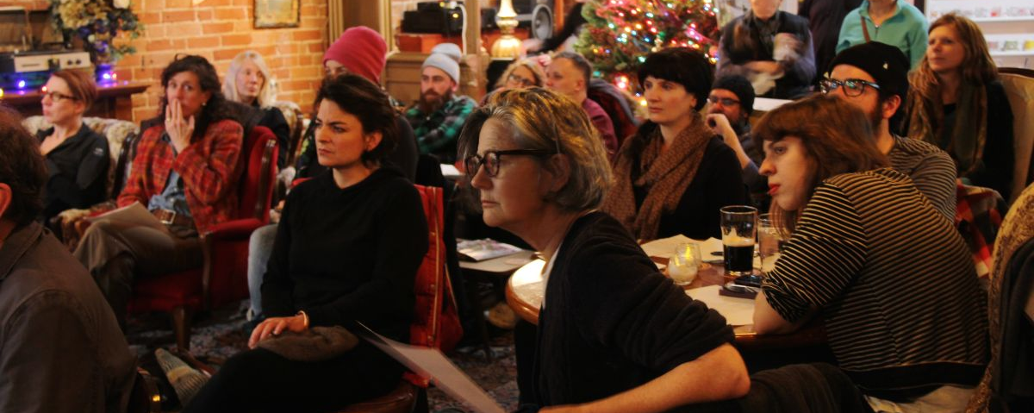
Thanks to you, our Members!

Slide 95
Thanks to Michael Gallant, Lett Architects and Dayle Finlay

Slide 96
THANKS TO TONIGHT’S STARS
Unity Singers (Joeann Argue, Heather Shpuniarsky, Barb Rivett, Brenda Maracle-O’Toole)
Niambi Leigh
Benj Rowland
Meagan Christou
Kerri Kennedy
Cara Mumford
Joeann Argue
Christy Haldane
Brigitta MacLeod
Anna Eidt
Erin Watson
Wendy Trusler
Black Honey

Slide 97
Thanks to Public Energy, the Peterborough Symphony Orchestra and New Stages for…

Slide 98
DOOR PRIZES
YOU MIGHT HAVE WON A PRIZE!!!
LOOK UNDER YOUR CHAIR AND BRING YOUR TICKET TO EVA AT THE BAR AND COLLECT YOUR PRIZE!!

Slide 99
Happy Holidays!
HAPPY HOLIDAYS TO ALL OF YOU FROM EVERYONE AT EC3!!
MAY 2018 BRING YOU HEALTH, HAPPINESS AND ALL THE CULTURE YOU CAN HANDLE!

Slide 100
Adjournment

