Slide 1


Electric City
Culture Council
Annual General Report
2019
Annual General Meeting 2018

Slide 2

Annual General Meeting 2019
WHO WE ARE
The Electric City Culture Council (EC3) is an arms- length, not-for-profit service organization dedicated to supporting and advancing the arts, culture and heritage (ACH) sector in Peterborough and the surrounding area.

Slide 3
Annual General Meeting 2019
OUR MISSION
Our mission is to develop and strengthen the creative ecology of the region by: Connecting individuals and organizations,
Providing strategic leadership and advocacy professional development, information, resources, networking, programming and collaborative partnerships, that build the capacity of the local arts, culture and heritage community. Bringing art and audiences together.

Slide 4
Annual General Meeting 2019
OUR JOB
Act as an antenna and sounding board for the ACH community.
Identify challenges in the sector and develop and deliver programs and services that help our members and the broader creative community, meet those challenges.
Discover new opportunities for artists, implement useful and innovative strategies to strengthen organizations and provide meaningful support to better serve artists, heritage professionals, cultural managers and audiences.
Build audiences and increase the impact of arts, culture and heritage activity.

Slide 5
Annual General Meeting 2019
WHAT WE DO
We deliver 10 programs and services for individual artists, arts organizations, heritage groups, and the broader cultural sector:
Provide new forums for exploring critical ideas, important issues, and creative innovations
Deliver professional development for individuals and organizations (workshops, clinics, mentorships)
Bring people together: dedicated sector coordination, connecting and convening
Organize advocacy, strategic leadership and representation

Slide 6
Annual General Meeting 2019
WHAT WE DO
Undertake original research, gather resources and share information about the local ACH sector, its needs and contributions, and the national scene
Develop networking, collaboration and partnerships that build and strengthen the capacity of the arts, culture and heritage community, across and between other sectors
Provide support services for arts and heritage organizations.

Slide 7
Annual General Meeting 2019
WHAT WE DO
Deliver award programs to honour and acknowledge outstanding artists and build recognition of local creators, arts supporters and cultural professionals
Organize collaborative/collective marketing initiatives
Produce arts awareness initiatives
Create new opportunities for artists to learn, develop, create and present their work

Slide 8

Annual General Meeting 2019
WHAT WE DO
Consolidate information and resources for artists and
cultural managers
Produce new creative programming initiatives that build
bridges across different disciplines and community sectors
and encourage public appreciation of and engagement with
arts, culture and heritage activities

Slide 9
Annual General Meeting 2019
HOW WE DO IT
Cultural Incubators (panels, lectures and round table discussions)
Professional Development Workshops and Mentorship Programs
Artsweek (biennial, 10 day, multidisciplinary festival
with over 100 artists) coming September 18th to
September 27th, 2020

Slide 10
Annual General Meeting 2019
HOW WE DO IT
Advocacy Initiatives and
Strategic Leadership
Arts Awards, Mayor’s Lunch, Bursary Programs
Electric City Culturecast on Trent Radio
92.7 FM (every other week)

Slide 11
Annual General Meeting 2019
HOW WE DO IT
Residency Programs
Poet Laureate
Commissioning Programs
Special Projects (Arts Programming)
Cross Promotion and Communications

Slide 12
Annual General Meeting 2019
HOW WE DO IT
One on One Consultations & Organizational
Capacity Building Service (FUZE)
Research Development and
Knowledge Sharing (CULTURE LAB)

Slide 13
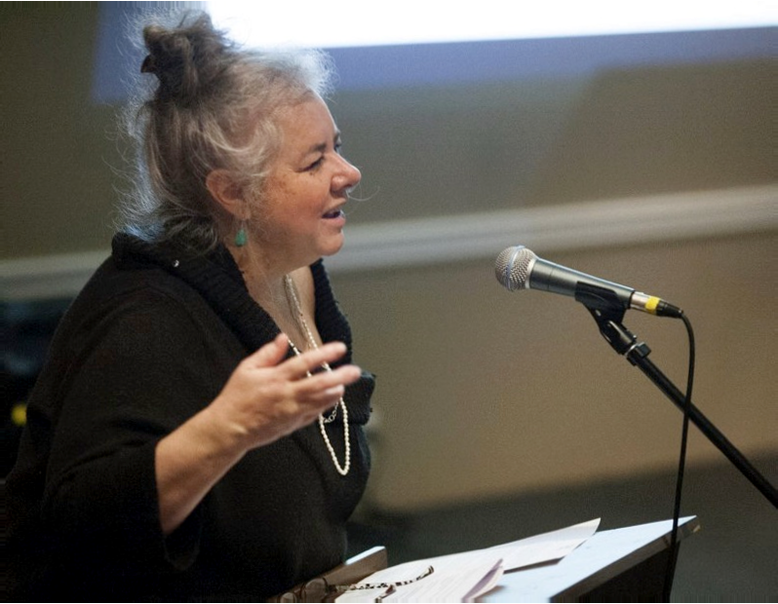
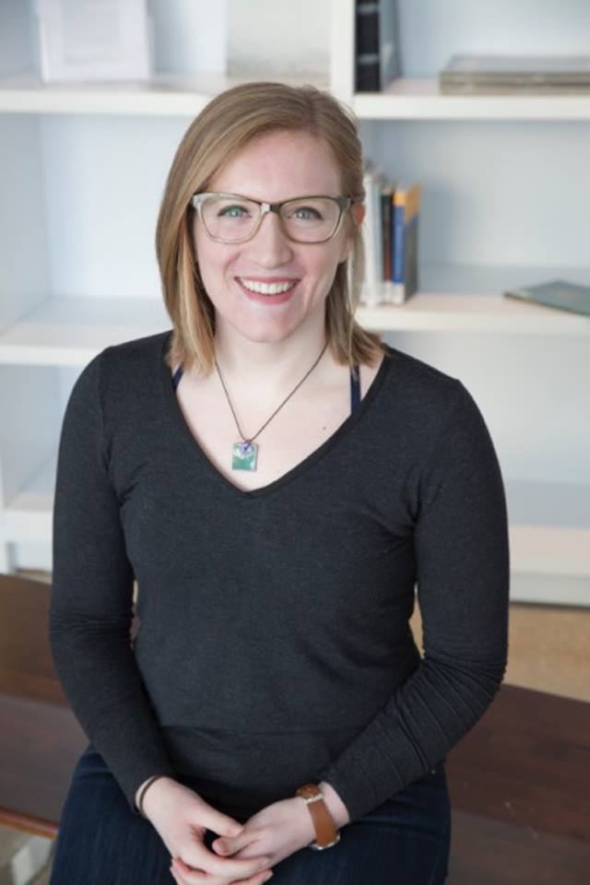
Annual General Meeting 2019
WHO MAKES IT HAPPEN?
Su Ditta
Executive Director
Anne White
Program Manager
Hannah Keating
Arts Awards Lead

Slide 14
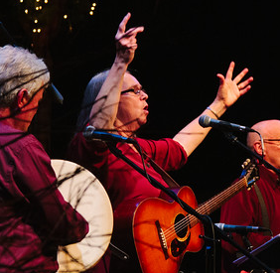
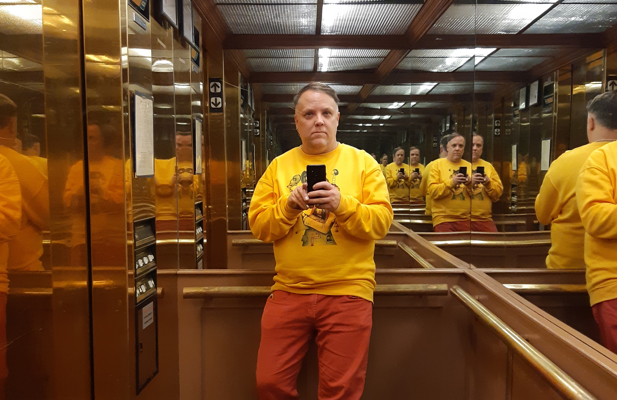
Annual General Meeting 2019
WHO MAKES IT HAPPEN?
Susan Newman
Director of Bookkeeping
Jeff Macklin
Master of Imagery

Slide 15
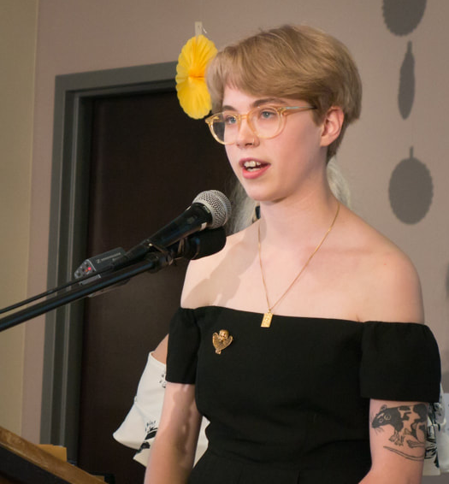
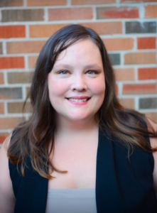
Annual General Meeting 2019
WHO MAKES IT HAPPEN?
Jem Woolidge
Summer Student, Archive Wrangler
Eva Fisher
Lapsed Program Manager, Beloved Occasional Volunteer

Slide 16
Annual General Meeting 2019
Special thanks to Bill Kimball,
Electric City Culture Council Board President

Slide 17

Annual General Meeting 2019
Endless thanks to EC3’s remarkable Board 2019 Members:
Kate Story (VP), Nadine Changfoot (Sec./Treasurer), Randy Read,
Sue McGregor-Hunter, Elisha Rubacha,
Alex Bierk, Mauricio Interiano

Slide 18
Annual General Meeting 2019
It wouldn’t be possible without the support of:
Terry Guiel (DBIA), Michael Gallant (Lett Architects), Bill Lett (Lett Architects), Paul Bennett (Ashburnham Realty), Bill Lockington (LLF Lawyers), Andy Carroll, Dan English, Sarah Cullingham, Mark Seasons, and so many friends and volunteers!

Slide 19
Annual General Meeting 2019
We hire artists to perform at many of our events and whenever possible hire artists to deliver services - design, bookkeeping or management and project planning and development services.

Slide 20
Annual General Meeting 2019
Audit: 2018-2019

Slide 21
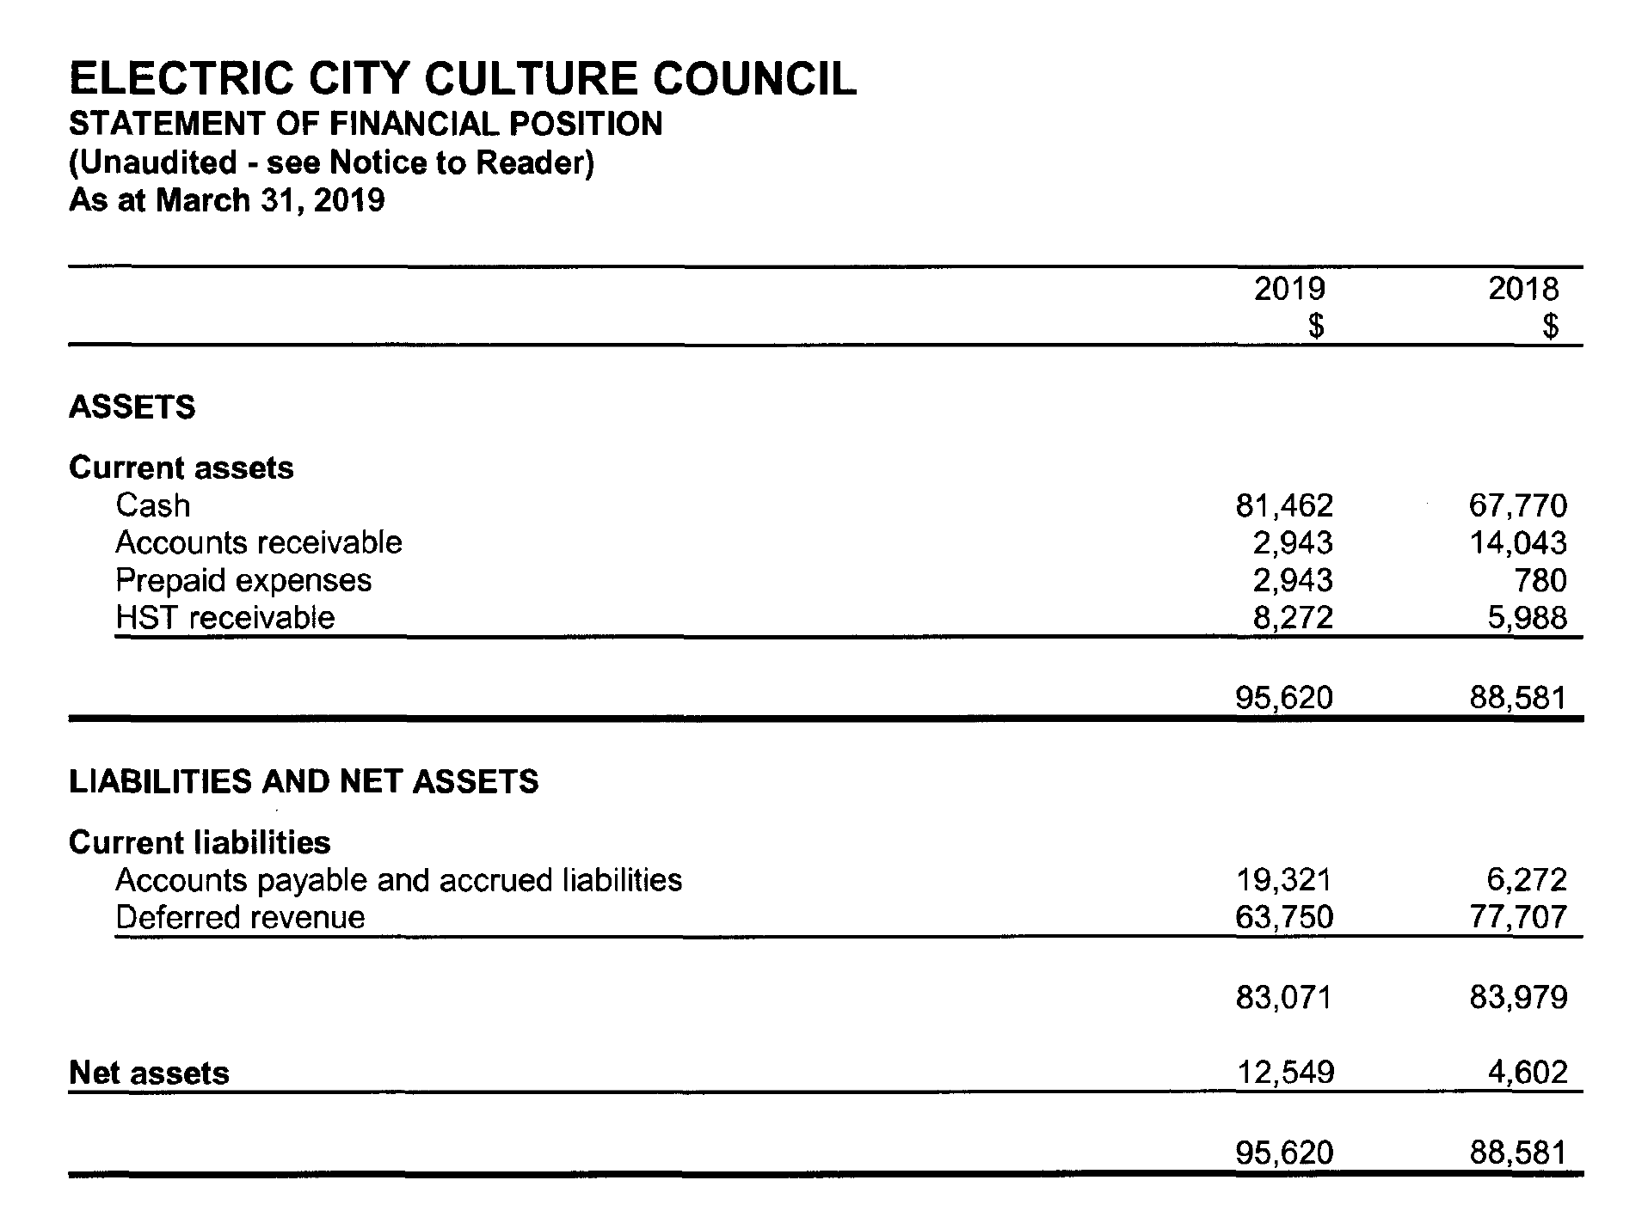

Slide 22
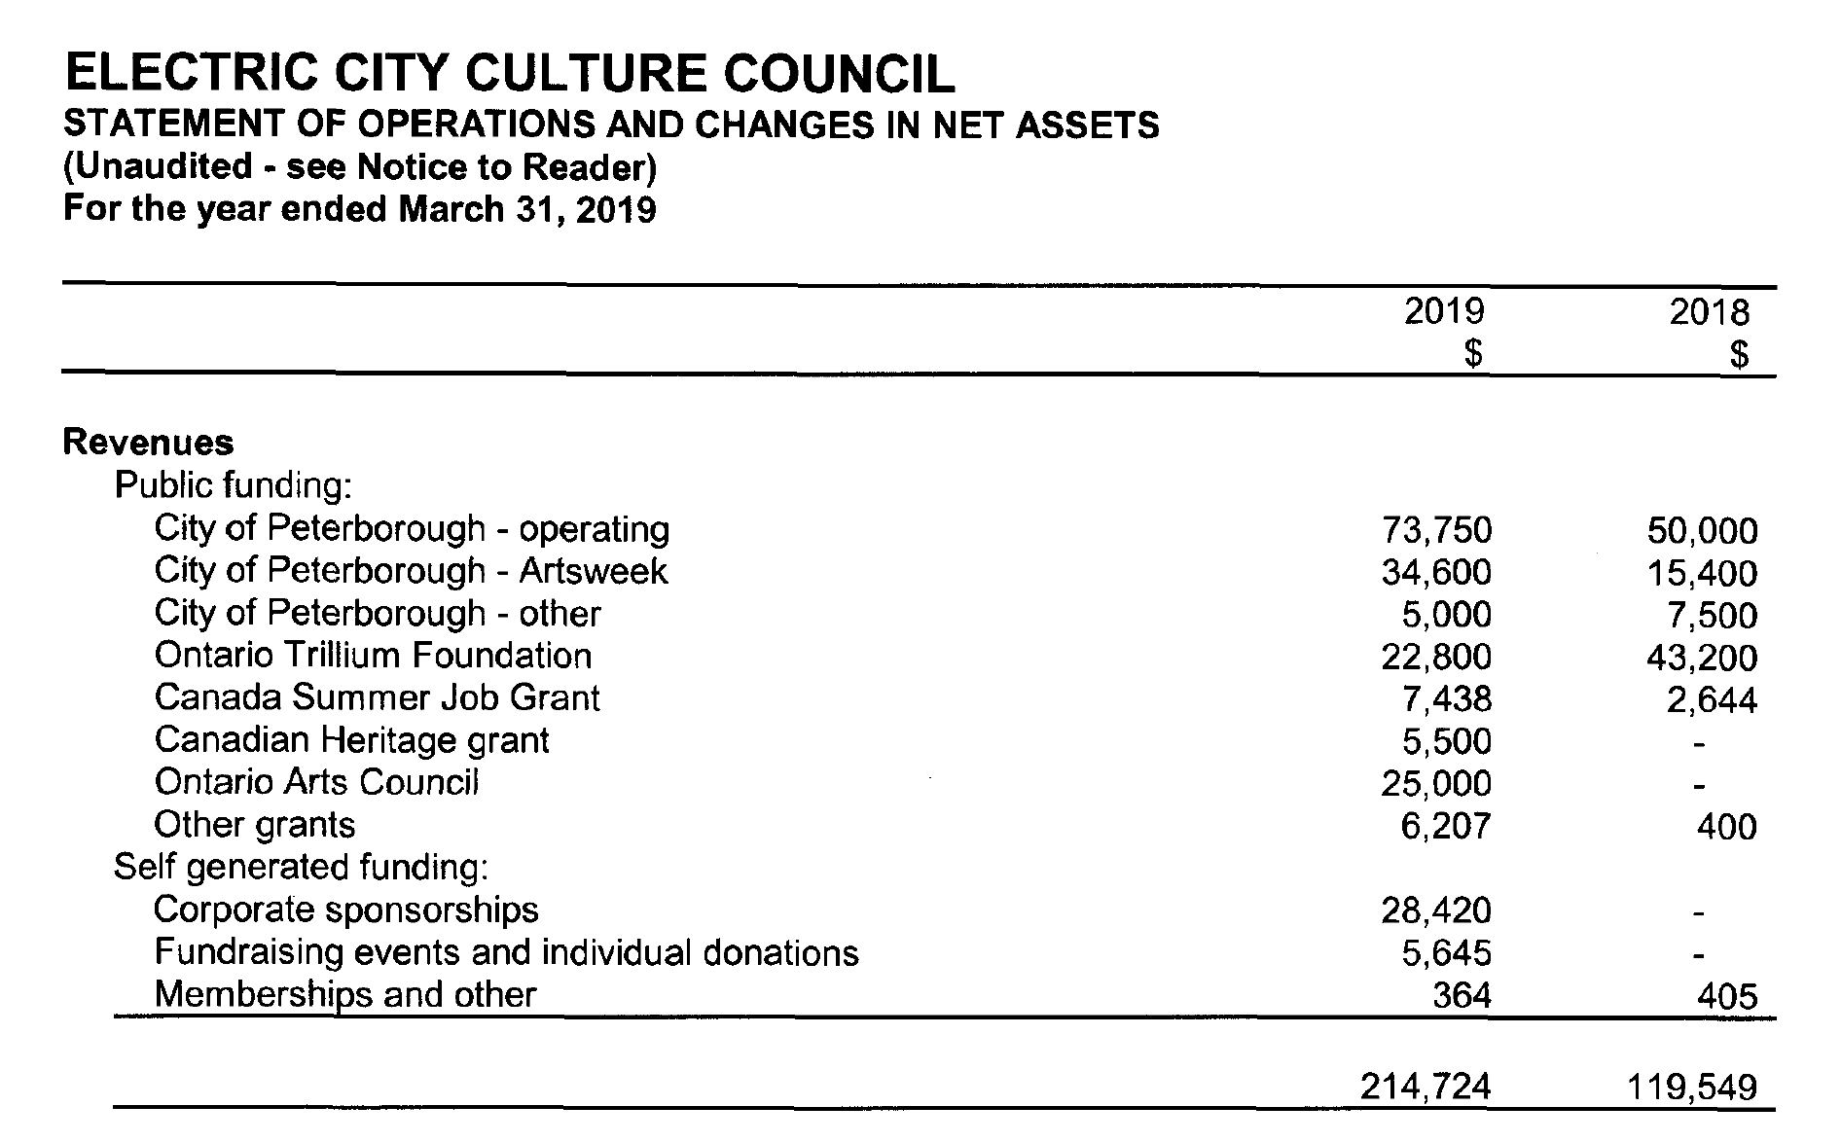

Slide 23
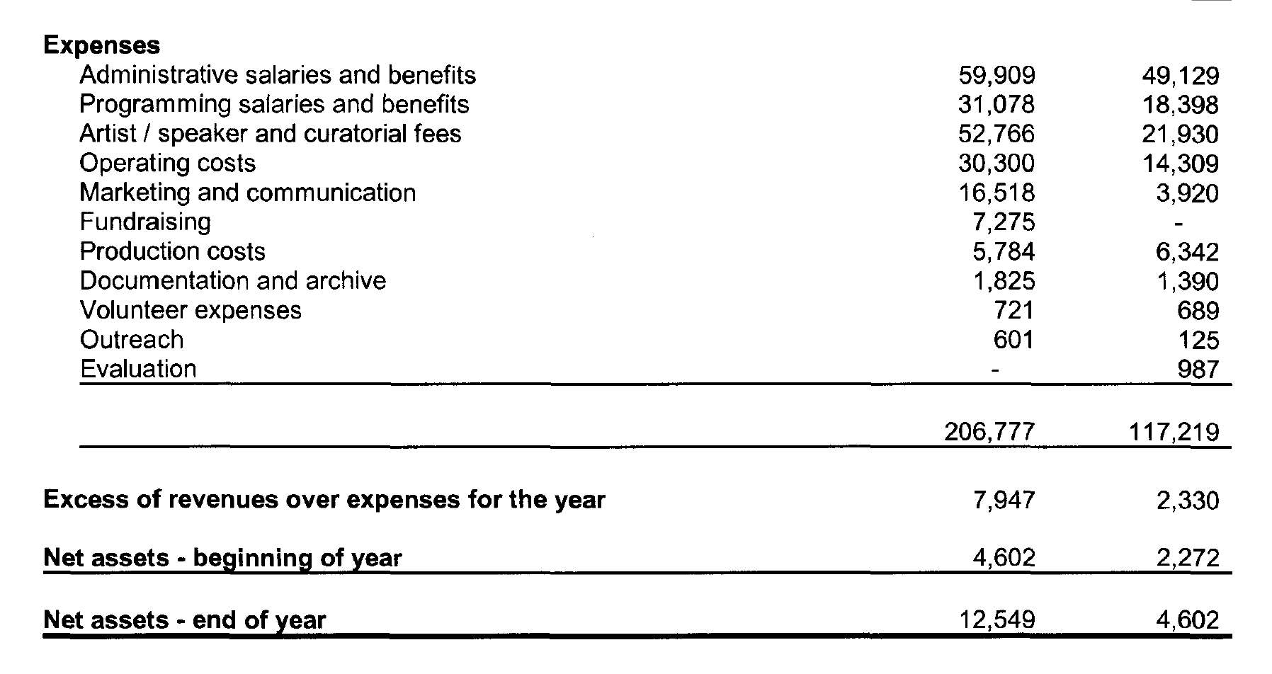

Slide 24
Annual General Meeting 2019
Governance
Each year, EC3 canvasses our existing board, undertakes a needs assessment and forecast and completes a skills and demographics analysis to determine what kind of new board members are needed. Strategic recruitment helps us build a short list of potential new members.
Notes:
Each year EC3 canvasses our existing board, undertakes a needs assessment and forecast, and completes a skills and demographics analysis to determine what kind of new board members are needed. Both public calls and strategic recruitment help us build a short list of potential new members.

Slide 25
Annual General Meeting 2019
Governance
A shortlist of potential board members is developed by the Governance Committee, and approved by the current Board of Directors. The Executive Director and the Board Chair begin the recruitment process and then offer an invitation to potential new board members who are approved by the board and presented at the AGM for ratification.
Notes:
Each year EC3 canvasses our existing board, undertakes a needs assessment and forecast, and completes a skills and demographics analysis to determine what kind of new board members are needed. Both public calls and strategic recruitment help us build a short list of potential new members.

Slide 26
Annual General Meeting 2019
Returning Board Members
The following Board Members are continuing their terms:
Bill Kimball
Kate Story
Elisha Rubacha
Alex Bierk
Nadine Changfoot
Notes:
Each year EC3 canvasses our existing board, undertakes a needs assessment and forecast, and completes a skills and demographics analysis to determine what kind of new board members are needed. Both public calls and strategic recruitment help us build a short list of potential new members.

Slide 27
New Board Nominees
Annual General Meeting 2019

Slide 28
Peg McCracken
EC3 BOARD NOMINEES
Peg McCracken’s love of music and passion for helping people has been the focus of her life and career. She volunteered as concert coordinator (1989-present) for the Peterborough Singers at its inception 30 years ago and now works as the choir’s Business Manager (2011-present)—a position which touches on all aspects of arts management. Peg started her career teaching music therapy to special needs children for ten years in Toronto. In 1991 she, and her husband Steve, created a family business called B Flat Music Co. to serve the needs of schools throughout the Kawartha and Durham area. Peg is also a dedicated hospice volunteer with forty years of experience. Her “joie de vivre” (‘joy in life’) flows from a life full of music and compassion for everyone she meets. Sharing the universal melody of the arts, and especially music, is her life.

Slide 29
Chad Hogan
EC3 BOARD NOMINEES
Chad Hogan is the General Manager of the Market Hall Performing Arts Centre
where he has established a concert presentation series bringing
approximately 40 artists from around the globe on an annual basis. Chad is a
founding member of the Ontario Presents Community Presenters Network ( a
joint union to empower small halls to work together), a member of the
Peterborough Chamber Commerce Policy Committee, and is involved in a number of community projects. Chad holds a Bachelor of Commerce from Ryerson University with a major in Business Law and a Marketing Diploma from Fleming College. Prior to his role at the Market Hall, Chad taught music for 8 years & served as a marketing & events advisor at the Chamber of Commerce for 3 years, as well as held seats on several boards & committees throughout the city.

Slide 30
EC3 Annual Report
Programs and Services
2019
Annual General Meeting 2019

Slide 31
Professional Development Workshops 2019
Annual General Meeting 2019
Peterborough Arts Awards: Nominator and Nominee Application
Workshop
Art and Addiction
Grantwriting 3.0: Indigenous Artists and Curators
WORK, WORK, WORK X 2: Status of the Artist Review

Slide 32

A roundtable discussion led by Alex Bierk and facilitated by Gord Langill. Naloxone Kit training: PARN, Peterborough Public Health and Peterborough Drug Strategy

Slide 33

A one day intensive workshop at the Nogojiwanong Friendship Centre with Indigenous artists and curators, elders, and officers from the Canada Council and the Ontario Arts Council

Slide 34

Presented in partnership with Precarious2: Peterborough ArtsWORK Festival 2019. This event provided an analysis of the 2017 Status of the Artist Report and set the stage for future action. Featuring: Kate Story, Elisha Rubacha, Anna Currier, Su Ditta, Karl Beverage and Annie Jaeger

Slide 35
Poster for TCCR Research Fair 2018, Anna Currier: Preliminary results
Over 230 people took part in the survey

Slide 36
Annual General Meeting 2019
Cultural Incubators 2019
Artsvote Canada 2019
Art and Addiction
WORK WORK WORK x 2: Status of the Artist Report in Review
Notes:
Adjust header

Slide 37

Artsvote Canada 2019
The official Candidate’s Debate on Arts Culture and Heritage for the Federal Election
Candidates Maryam Monsef, Candace Shaw, Michael Skinner and Andrew McGregor went head to head with our panel of experts: Katherine Carleton, Joeann Argue, Emily Martin and Elisha Rubacha. Moderated by James Cullingham

Slide 38
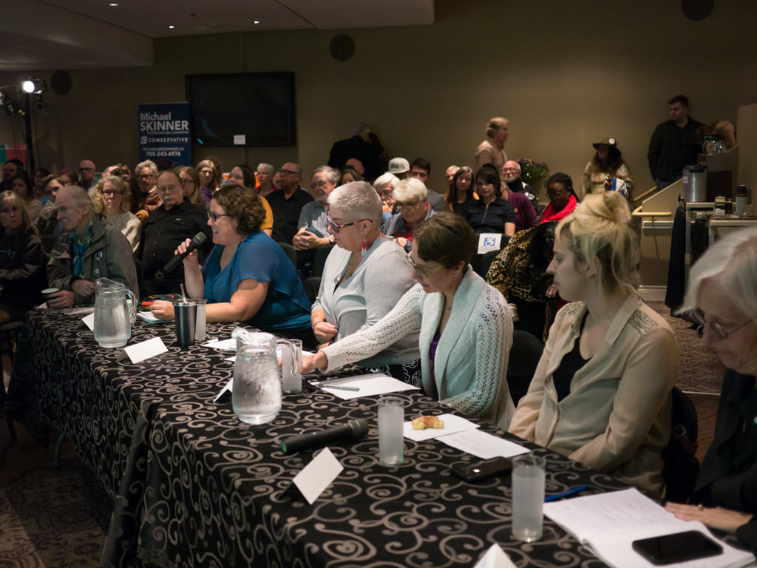

Slide 39
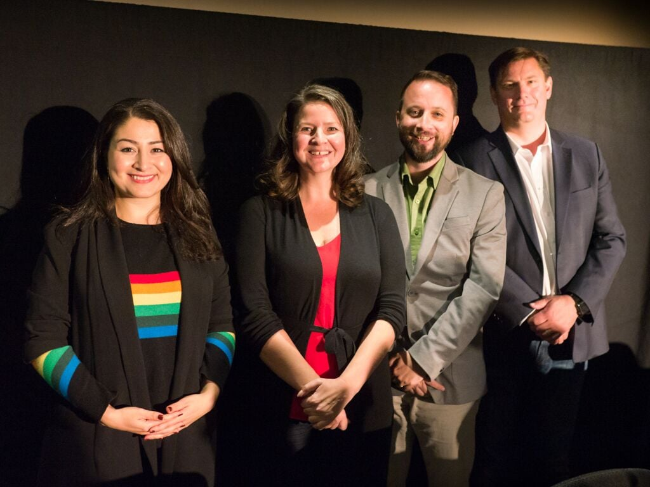

Slide 40
Advocacy and Strategic Leadership 2019: Engagement
Annual General Meeting 2019
First Friday
City Hall: Campaign to overturn the $31,000 cut to the 2019 Community Investment and Project Grants Budget
City Hall: Successful advocacy campaign for fee for Poet Laureate

Slide 41
Advocacy and Strategic Leadership 2019: Engagement
Annual General Meeting 2019
Official Plan Update: Organized Artist participation in planning department consultations
City Hall: Organized ACH Sector participation in Budget 2020 Open Houses
Arts Awareness: Arts representation, lectures and talks

Slide 42
Advocacy and Strategic Leadership 2019: Research
Annual General Meeting 2019
Official Plan Update Submission: Conducted focus group on Official Plan Update: Arts Sector input and remedies for gentrification impact
Official Plan Update: Research, development and delivery of EC3’s response to the DRAFT Official Plan Update
Support for the Arts: Comparative research on other municipalities (arts council structure, grants programs, etc)

Slide 43


Slide 44
Advocacy and Strategic Leadership 2019: Research
Annual General Meeting 2019
Support for the Arts: Comparative research on arm’s length and peer assessment, municipal arts councils (funding, governance, operations)
Support for the Arts: Comparative analysis of Community Investment and Project Grants Program results
Support for the Arts: Development of advocacy and educational campaign for Peterborough City Council, including background research, statistics, local arts landscapearts impact, profiles.

Slide 45
Annual General Meeting 2019
Special Projects
Peterborough Arts Awards & Mayor’s Luncheon for the Arts
Bierk Art Bursary Program
Downtown Artists in Residence Program
Art Loves Pride
Civic Awards Nominations
Poet Laureate Program
Mentorship Program

Slide 46

May 2019,
McDonnel Street Activity Centre

Slide 47
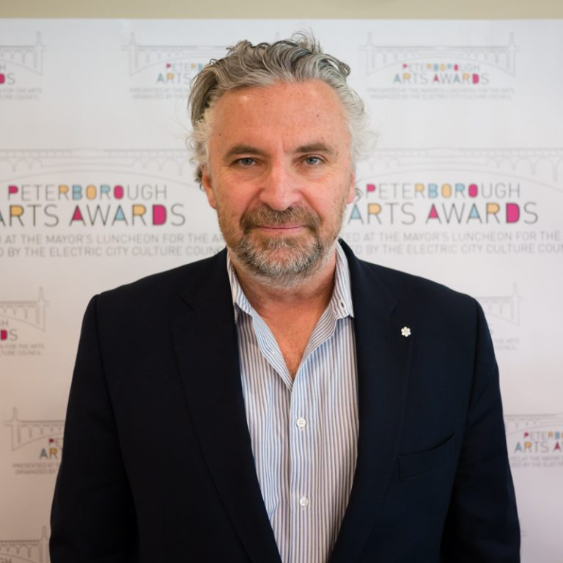
Peterborough’s Arts Awards program!!
Guest Speaker: Charlie Foran
6 prizes of $2,000 each:
Emerging Artist
Mid-Career Artist
Senior Artist
Indigenous Artist
Arts Champion
Arts Catalyst
8 Honorariums of $250 each for runners up

Slide 48
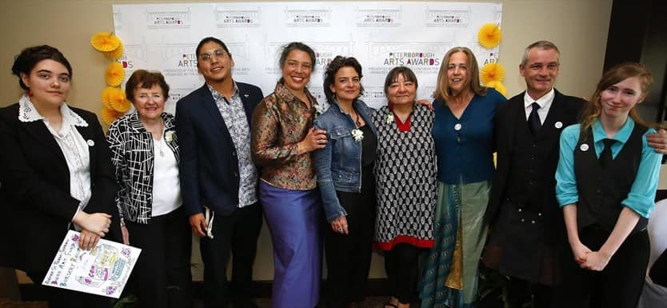
The winners of the 2019 Peterborough Arts Awards and BABs!

Slide 49
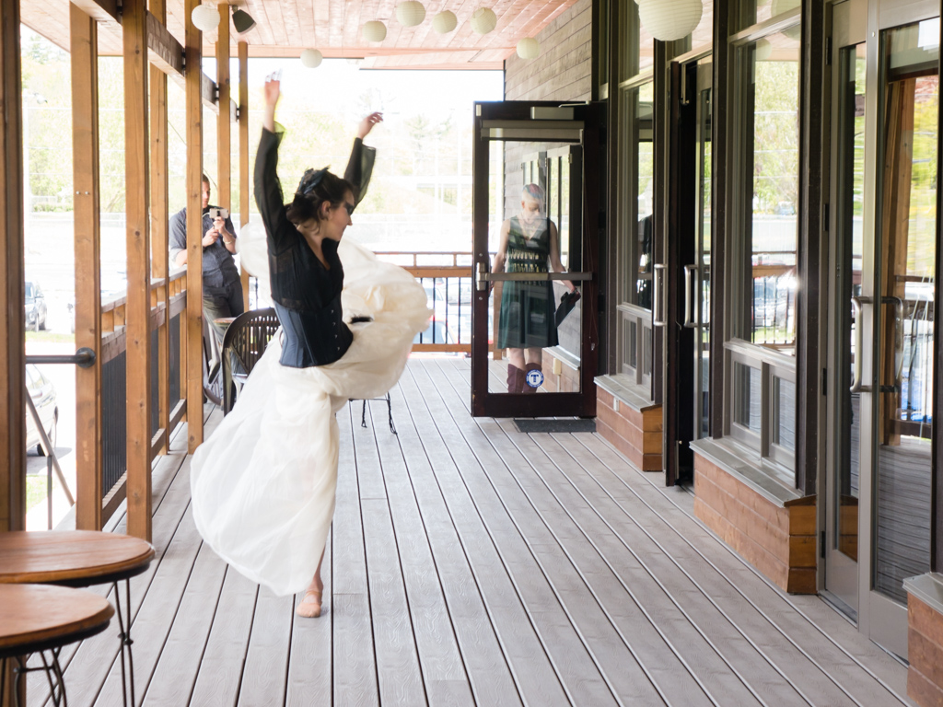
Performances by:
Curtis Driedger
Dreda Blow
Justin Million
Unity Singers
Tanah Haney
Beau Dixon and the cast of The Colour Purple

Slide 50
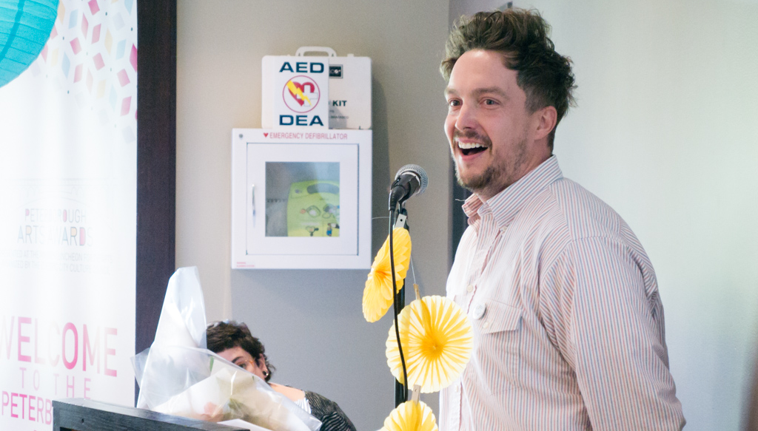
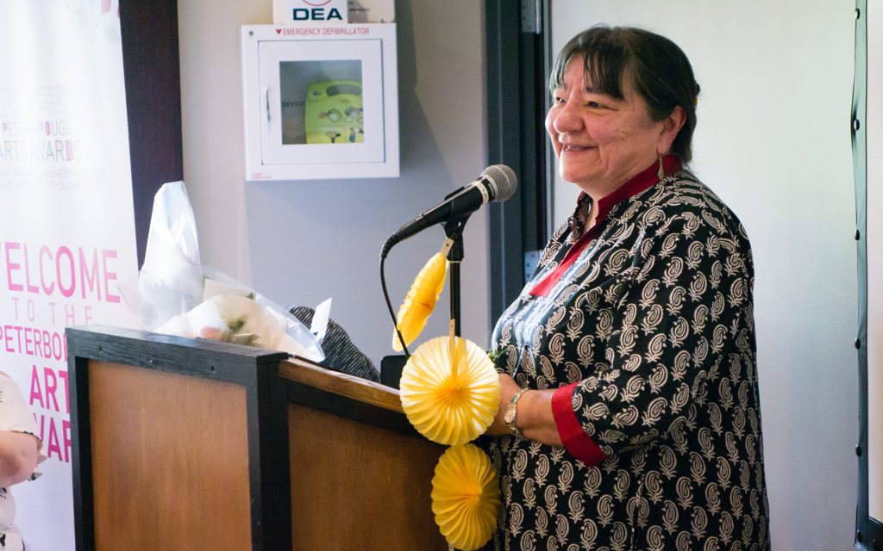
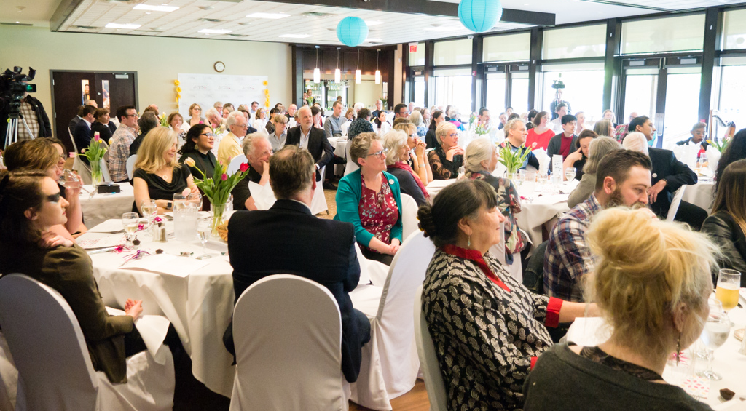
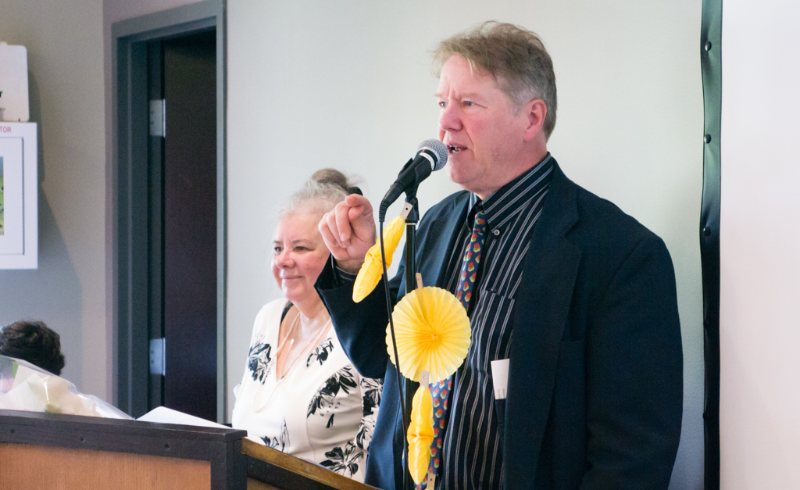

Slide 51
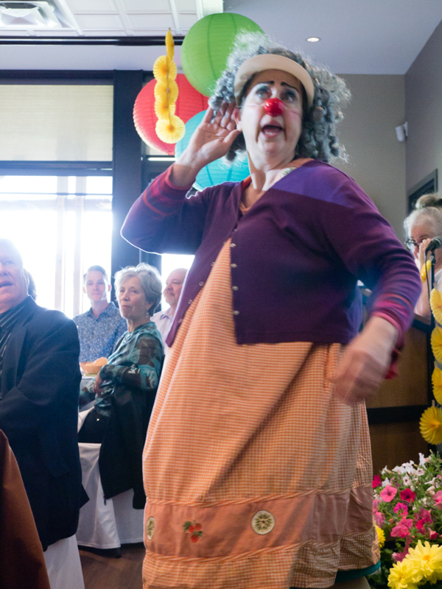
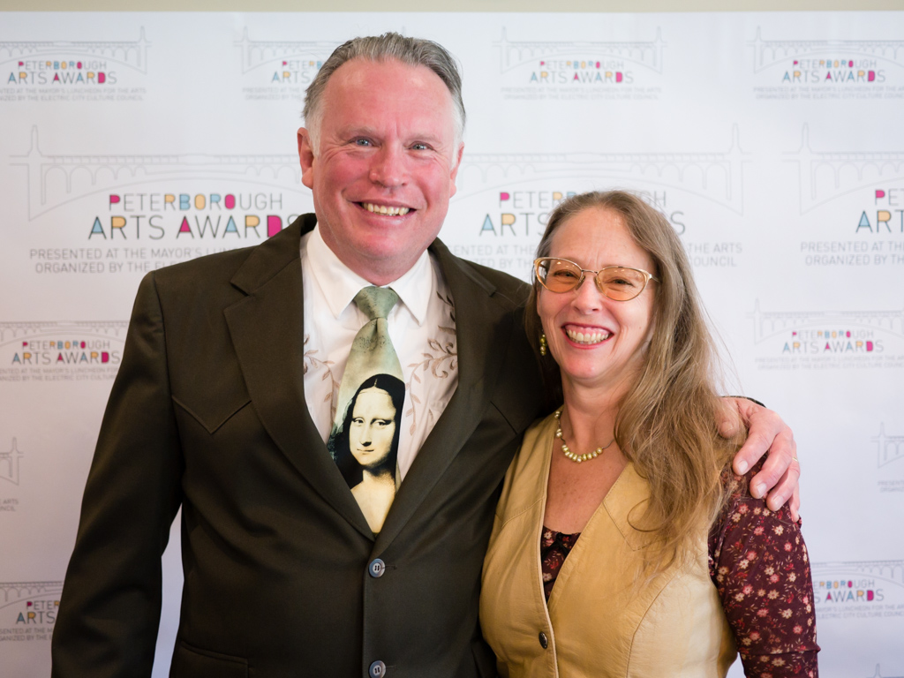
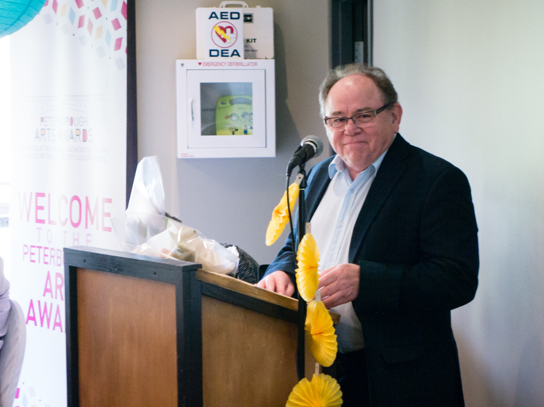
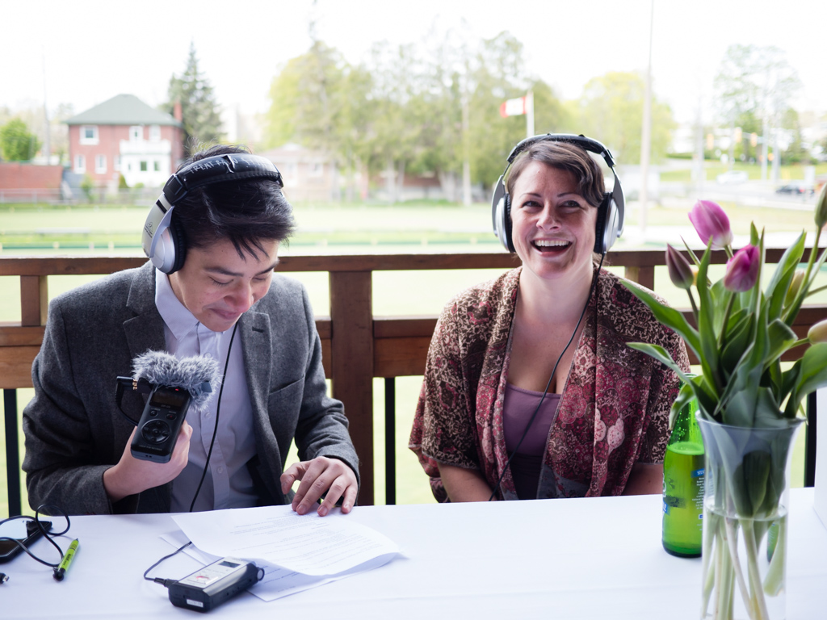

Slide 52

Peterborough Arts Awards Sponsors
Merit II Realty Limited - Outstanding Emerging Artist
Betty and Bill Morris - Outstanding Mid-Career Artist
Outpost 379 - Outstanding Senior Artist
LLF Lawyers - Outstanding Achievement by an Indigenous Artist
Ashburnham Realty - Arts Champion
Kate and Alex Ramsay - Arts Catalyst

Slide 53



Bierk
+ Art +
Fund
Bursaries Project
Two $1000 bursaries were presented to Peterborough students graduating from high school in 2019 to pursue visual arts education at the post-secondary level. Thanks to the AGP and Artspace for their support of this project. Thanks as well to our jurors: Fynn Leitch and Spencer Harrison

Slide 54
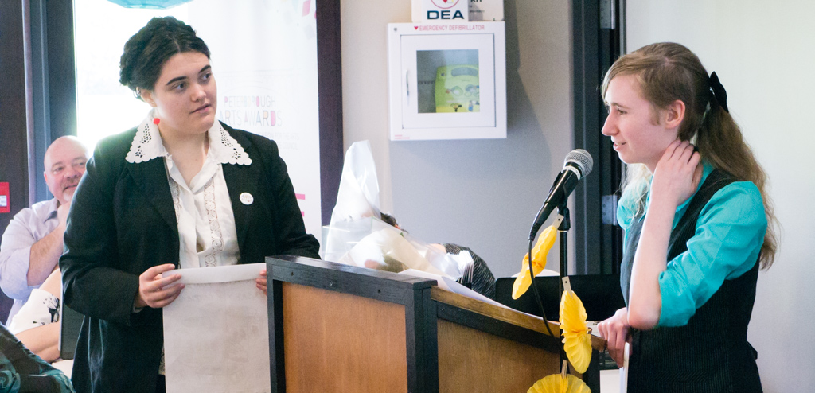
Alexina St. Pierre-Farrow (Left) and Payton Urbach (Right) giving BAF Bursary acceptance speech

Slide 55


Slide 56
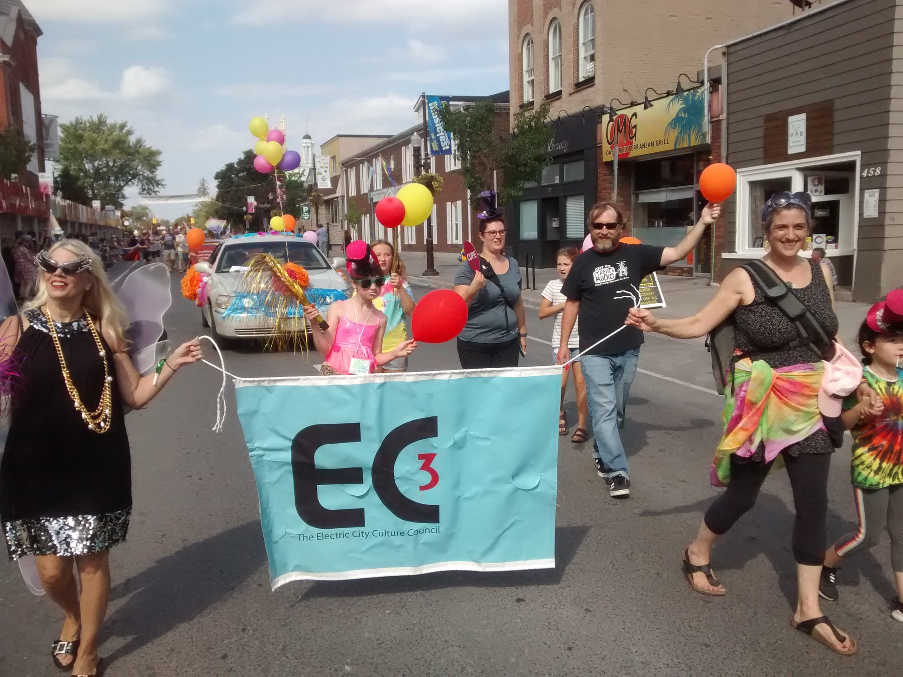

Slide 57
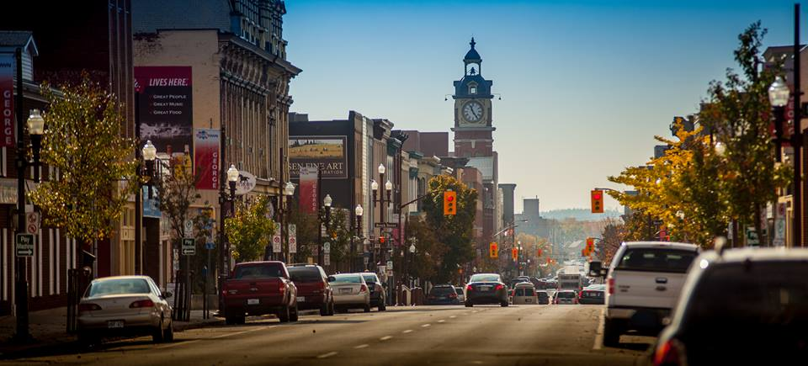

Downtown Artists in Residence Program
Notes:
Downtown Peterborough: George Street

Slide 58
EC3 Programming Coming Up Soon
Annual General Meeting 2019
EC3 has lots of great programming in development for 2019!
Notes:
Fix header

Slide 59

Annual General Meeting 2019
Peterborough Poet Laureate
Pilot Program 2020
In collaboration with:
The City of Peterborough
The Peterborough Poetry Slam Collective

Slide 60
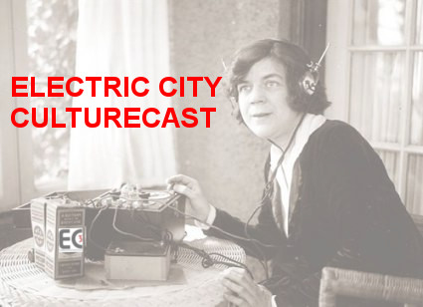

Slide 61


Annual General Meeting 2019
The Electric City Culturecast
A half hour radio broadcast, every other Wednesday night at 6:30 pm on Trent Radio at 92.7 FM on your radio dial. This magazine format show hosted by EC3 Executive Director Su Ditta includes news, reviews and feature interviews with people in the local arts, culture and heritage scene, along with music, an advice column and a cultural trivia quiz. It is also available by podcast through PIP (Peterborough Independent Podcasters).
This outreach and marketing initiative launched again in October. This year ECCC will focus on issues in the arts and individual artists and their practice. We produce 14 episodes annually.
Special thanks to Jill Staveley, Mauricio Interiano and John Muir

Slide 62
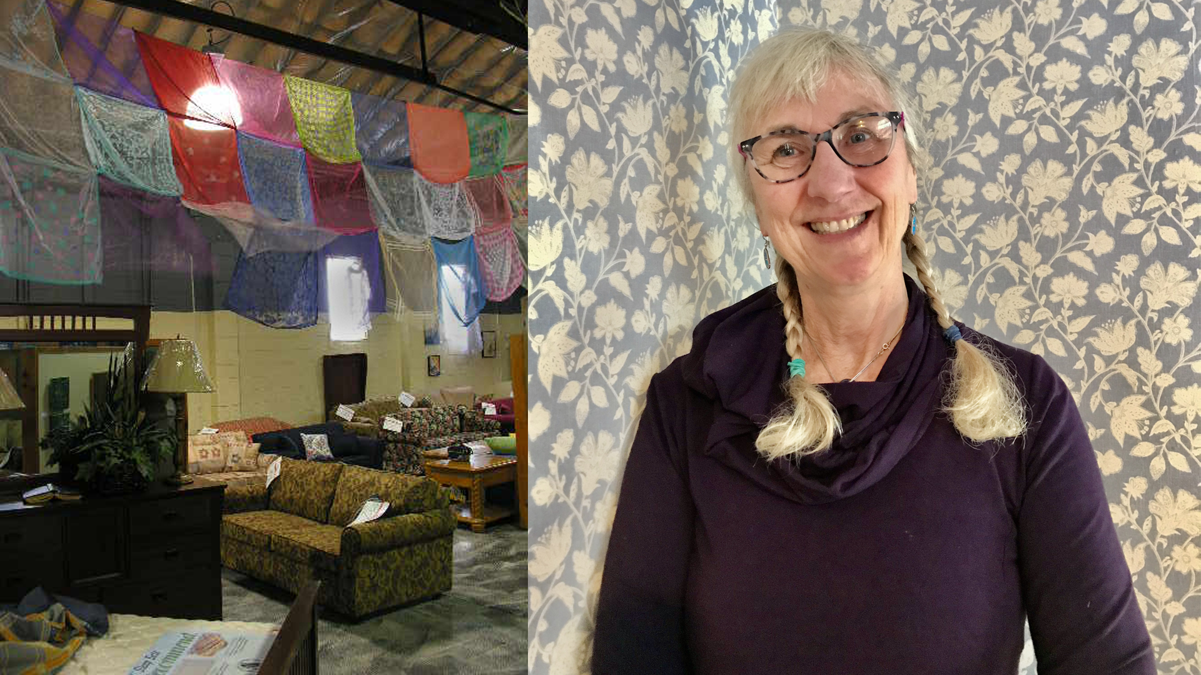

Slide 63

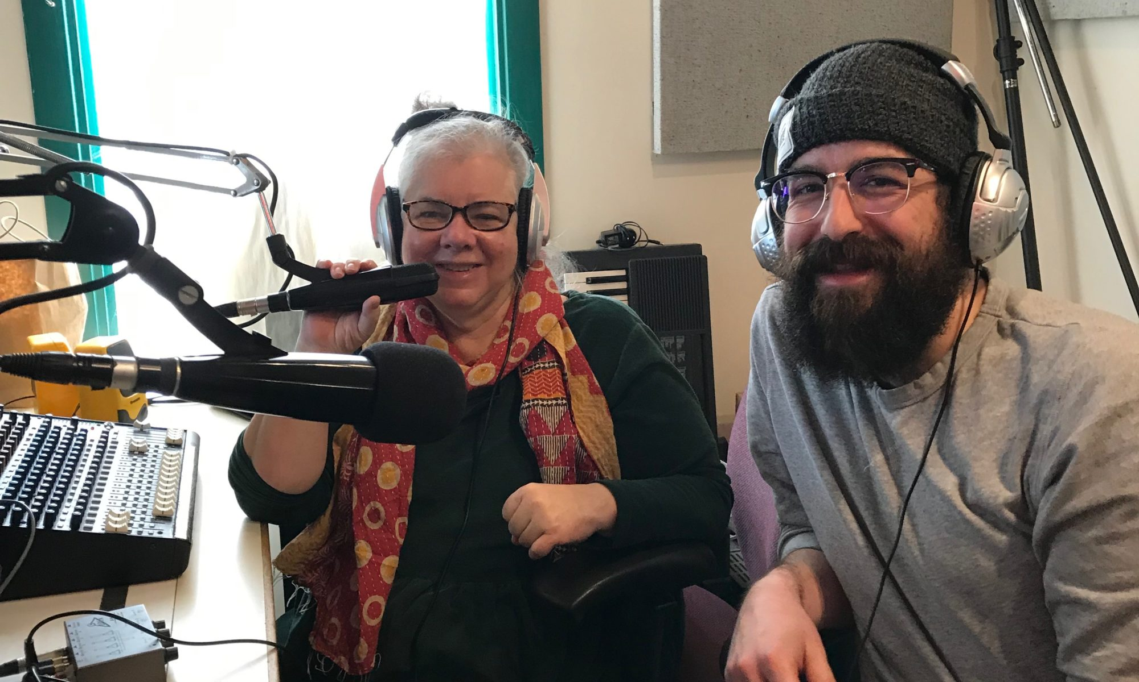

Slide 64
EC3 Programming Coming Up Soon
Stay tuned for information on…
Annual General Meeting 2019
Peterborough Arts Awards Nominations
Territorial Acknowledgements Workshop
Grantwriting 3.0: Professional Development Workshop and Mentorship Program for Indigenous Artists
Income Taxes Workshop
Interpreting CRA Regulations Workshop
and more!
Notes:
Fix header

Slide 65
Annual General Meeting 2019
Research, Skills, Knowledge, Information and Resource Sharing
Our team of professionals provides advice, support and direction for problem solving, new initiatives and skills development
Culture Lab
On-line Organizational Development and Capacity Building Tools (web site and Mail Chimps)
Tips, guides, media reports, video, publications, bibliography and informative links to further information posted in the resources section of every event on our web site
Resource Sharing
Podcasts, photos and videos posted on our websites for almost all EC3 projects and events.

Slide 66
Annual General Meeting 2019
Research, Skills, Knowledge, Information and Resource Sharing
Our team of professionals provides advice, support and direction for problem solving, new initiatives and skills development
Status of the Artist in Peterborough Research and Report
Research and report on economic and social status of local artists
FUZE
Arts management and capacity building hotline support services.
Call EC3 for advice and connections to information, learning resources and support networks and potential partners and allies.

Slide 67
Annual General Meeting 2019
Advocacy and Strategic Leadership
ACHAC (Arts, Culture and Heritage Advisory Committee - City)
PAAC (Public Art Advisory Committee - City)
Community Investment Grants Budget Advocacy – City
Official Plan Update
City Community Wellbeing Plan Advisory Committee
DBIA Vibrancy Working Group

Slide 68
Annual General Meeting 2019
Advocacy and Strategic Leadership
Maryam Monsef: SOCAD and Status of Women and Sub Committees
Ontario Arts Council Consultation
Canadian Coalition for the Arts / Ontarians For the Arts
Government of Ontario Pre-budget Consultations
MASS Culture
Artsvote (Federal Election 2019)

Slide 69
Strategic Ad Hoc Representation
City Rebrand Consultations
Downtown Property Tax Relief
Peterborough Economic Development: Tourism Consultation
Chamber of Commerce, Trent
CFGP: Vital Conversations Dinner and Lunch
Annual General Meeting 2019

Slide 70

FUZE: Support Services
SPARC, Peterborough Singers, The Theatre on King, and PRHC Art Collection to name a few!

Slide 71
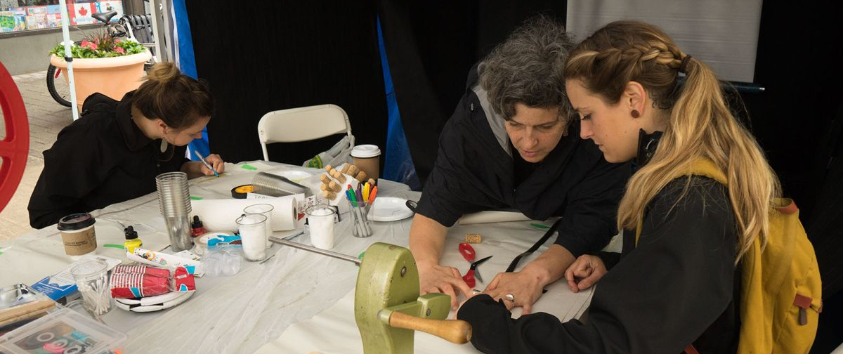
Thanks to our Volunteers,
We couldn’t do it without you!
Notes:
Logo/header

Slide 72
Annual General Meeting 2019
ACKNOWLEDGEMENTS
The work that EC3 does would not be possible without
the generous support and encouragement of so many
funders and sponsors…..
Our sincere appreciation and heartfelt thanks to:

Slide 73

Special thanks to the City of Peterborough

Slide 74




Heartfelt thanks to all of our other Funders:

Slide 75
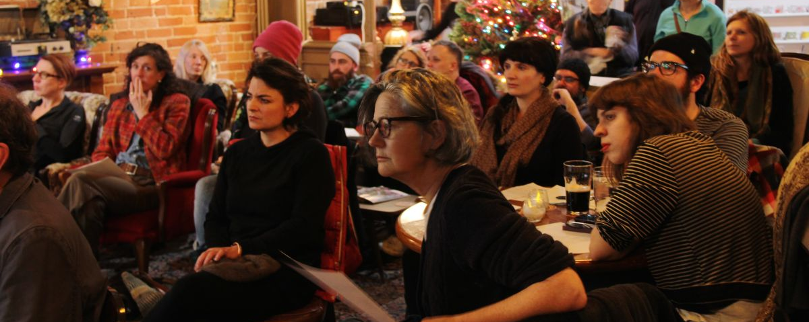
Thanks to our Members!

