Slide 1
ONCA is Finally Here!
What’s new in the ONCA?
What steps do nonprofits need to take?
How can CLEO help?
Presented by:
Benjamin Miller
November 24, 2021

Slide 2
Notes:
I know that many of you are familiar with CLEO and the work we do but I think there may be some people on the webinar who haven’t connected with us before. So just to say that CLEO produces reliable, plain language legal information for people living on low-incomes and those who are marginalized for many different reasons. The information is available in French and English and in some other languages through the CLEO, Steps to Justice, and Justice pas a pas websites. We also provide training, tools, and opportunities for connection for community workers who help people with their legal problems through our website, CLEO Connect

Slide 3
Housekeeping
There will be a period for questions at the end of each section, but feel free to ask questions throughout by unmuting or typing in the chat.

Slide 4
Disclaimer
This presentation is:
general legal information – it isn’t legal advice tailored for your specific situation.
a high-level overview of ONCA – it isn’t comprehensive and it doesn’t address other areas of law, such as charity law.
about law not best practices. Just because something is legal doesn’t mean it’s a good idea.
about law not funder expectations.

Slide 5
Land Acknowledgement
We acknowledge that since time immemorial the land on which we live and work has been the home and traditional territory of Indigenous Peoples, including the Mississaugas of the Credit, Haudenosaunee and Wyandot, and is now home to many diverse First Nations, Inuit, and Métis relatives. CLEO’s work is also carried out across the many traditional territories of this land that is also known as Ontario. We acknowledge our privilege as well as our role in the systems of colonization.
CLEO staff are learning to be better allies by participating in training about the systemic nature of anti-Indigenous racism in Canada. We are strengthening ties to Indigenous-serving organizations in order to produce information and resources that reflect the experience of Indigenous Peoples, and develop training that is more relevant for and accessible to Indigenous Peoples.

Slide 6
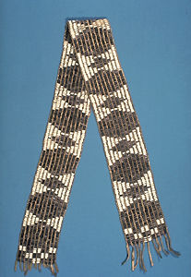
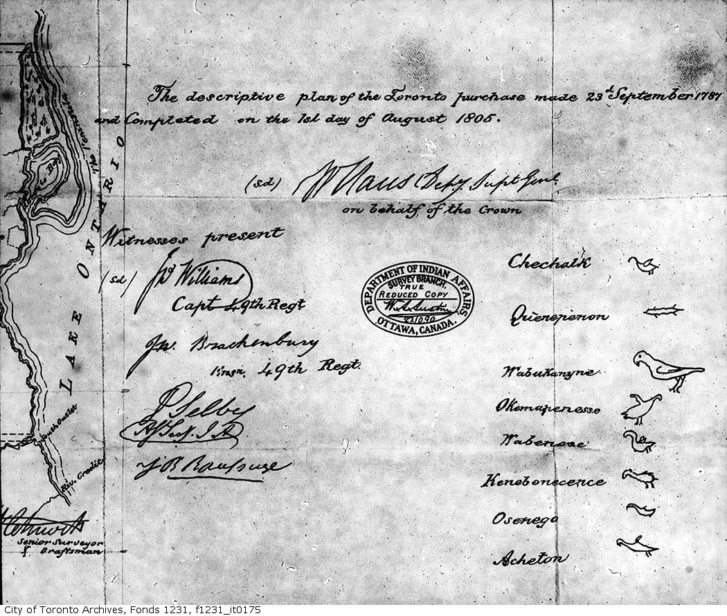
Dish With One Spoon v Treaty 13
Vs.

Slide 7
Key Terms
ONCA: The legislation that most nonprofits incorporated under provincial law will need to follow. It replaces Ontario’s Corporations Act.
Letters Patent: Now called “articles”. The document the government gave you when you incorporated. It includes your purposes, address, and other special rules.
Members: The people who are called members in your bylaws or who have governance powers like electing the directors or appointing the auditor.

Slide 8
Why Care About the ONCA?
Opportunity to revisit your governance
Some new things are possible
Funders may ask
Avoid confusion later on
There are no ONCA police, so don’t worry!

Slide 9
What’s new in the ONCA?
Public Benefit Corporations
Financial Review Standards
Ontario Business Registry

Slide 10
Public Benefit Corporations (PBCs)
A nonprofit is a PBC if it:
is a registered charity, or
receives more than $10,000 in:
grants or financial assistance from the government
gifts or donations from sources other than members, directors, officers, or employees
Every year a nonprofit qualifies, the next year it is a PBC.
PBCs:
face a higher standard of financial review
can distribute their property only to the government or a similar PBC if they dissolve (applies for three years)
can’t have more than a third of its directors be employees (including ex-officio directors)

Slide 11
Financial Review Standards
Annual revenue | Public benefit corporation | Not a public benefit corporation
$0-$99,999.99 | You can pass an extraordinary resolution that says you don’t need to do an audit and a review engagement | You can pass an extraordinary resolution that says you don’t need to do an audit and a review engagement
$100,000-$499,999.99 | You can pass an extraordinary resolution to have a review engagement | You can pass an extraordinary resolution that says you don’t need to do an audit and a review engagement
$500,000+ | You must have an audit | You can pass an extraordinary resolution to have a review engagement
Default
All nonprofits get an audit each year
Extraordinary Resolution
You can pass an extraordinary resolution with:
80% of votes at members’ meeting
Unanimous written resolution of all voting members

Slide 12
Ontario Business Registry
Benefits of the new online registry:
look up Ontario corporations online
make your annual filings and change your articles online
shorten the response to real time
automatically share information with the Public Guardian and Trustee, but not Canada Revenue Agency
There are glitches so watch out!

Slide 13
What steps do nonprofits need to take?
Step 1: Figure out whether ONCA applies to you
Step 2: Figure out when you need to act
Step 3: Get your books in order
Step 4: Update your bylaws
Step 5: Update and file articles

Slide 14
Step 1: Figure out whether ONCA applies to you
ONCA applies to nonprofits incorporated under:
Ontario’s Corporations Act
Most special Acts - in case of conflict, special Act applies
Disclaimer: Tax status and corporate status are different.
ONCA does not apply to nonprofits incorporated under:
Canada Not-for-Profit Corporations Act
Co-operative Corporations Acts
Business Corporation Acts

Slide 15
Step 2: Figure out when you need to act
October 19, 2021: ONCA took effect
Until October 18, 2024: Old (valid) letters patent and bylaws continue to be valid whether they comply with ONCA or not.
October 19, 2024 and beyond: Letters patent and bylaws automatically changed to comply with ONCA, except key provisions such as:
number of directors
member classes and voting rights
dissolution clauses
Take-away: To avoid confusion, transition in next 3 years.

Slide 16
Step 3: Get your books in order
Collect the following documents:
Letters patent and supplementary letters patent
Bylaws
Minute books (can be virtual)
Special resolutions
Directors and officers register
Director consent forms
Members register
Annual revenue
Make sure the government has your right address (NOT a PO box) even if your filings are up to date because there have been glitches.

Slide 17
Steps 4-5: The Updating Process
Disclaimer: If your bylaws say a different process, follow that, but your members always have the final say.
Typical process:
Board approval: Helpful to have more than one director involved. Changes are valid until next members’ meeting.
Members meeting:
Notice must provide sufficient detail for members to make up their mind
Members approve, reject, or change
File with government: Registered charities file bylaws with CRA. All nonprofits file articles of amendment through ServiceOntario or PGT.

Slide 18
Step 4: Update your bylaws
Here are 5 examples of things that might need to change:
You must appoint a chair
Do you want corporations to be eligible for membership?
If you have multiple member classes
how to join the class
how membership ends
how to withdraw or transfer classes
Do you want members holding less than 10% of votes to be able to call a members’ meeting?
Do you want members to have a right to proxy voting?

Slide 19
Step 5: Update and file articles
Examples of things that might need to change:
Purposes: Do they reflect your organization’s goals?
Number of Directors: Minimum 3. Can be a range.
Membership classes and voting rights: If you have more than one class
Restrictions on nonprofit’s powers: borrowing, selling key assets
To file articles online you need a:
CompanyKey: Ask and they will mail it to you
ONe-Key: Sign up online
ServicesOntario Account: Sign up online
To file by mail you go to the Forms Repository.
You can still file through an intermediary.

Slide 20
How can CLEO help?
Nonprofit Law Ontario
CLEO’s Bylaw Builder
Sample bylaws with options
CLEO’s Guide to Adjusting Existing Bylaws
Email us your questions

Slide 21
Questions? Benjamin.miller@cleo.on.ca https://nonprofitlaw.cleo.on.ca

Slide 22
Thank you for joining us! Subscribe – nonprofitlaw.cleo.on.ca

